Slide 1
Dementia, Caregiving & Sexual & Gender Diversity
Professor Mark Hughes
Southern Cross University
mark.hughes@scu.edu.au

Slide 2
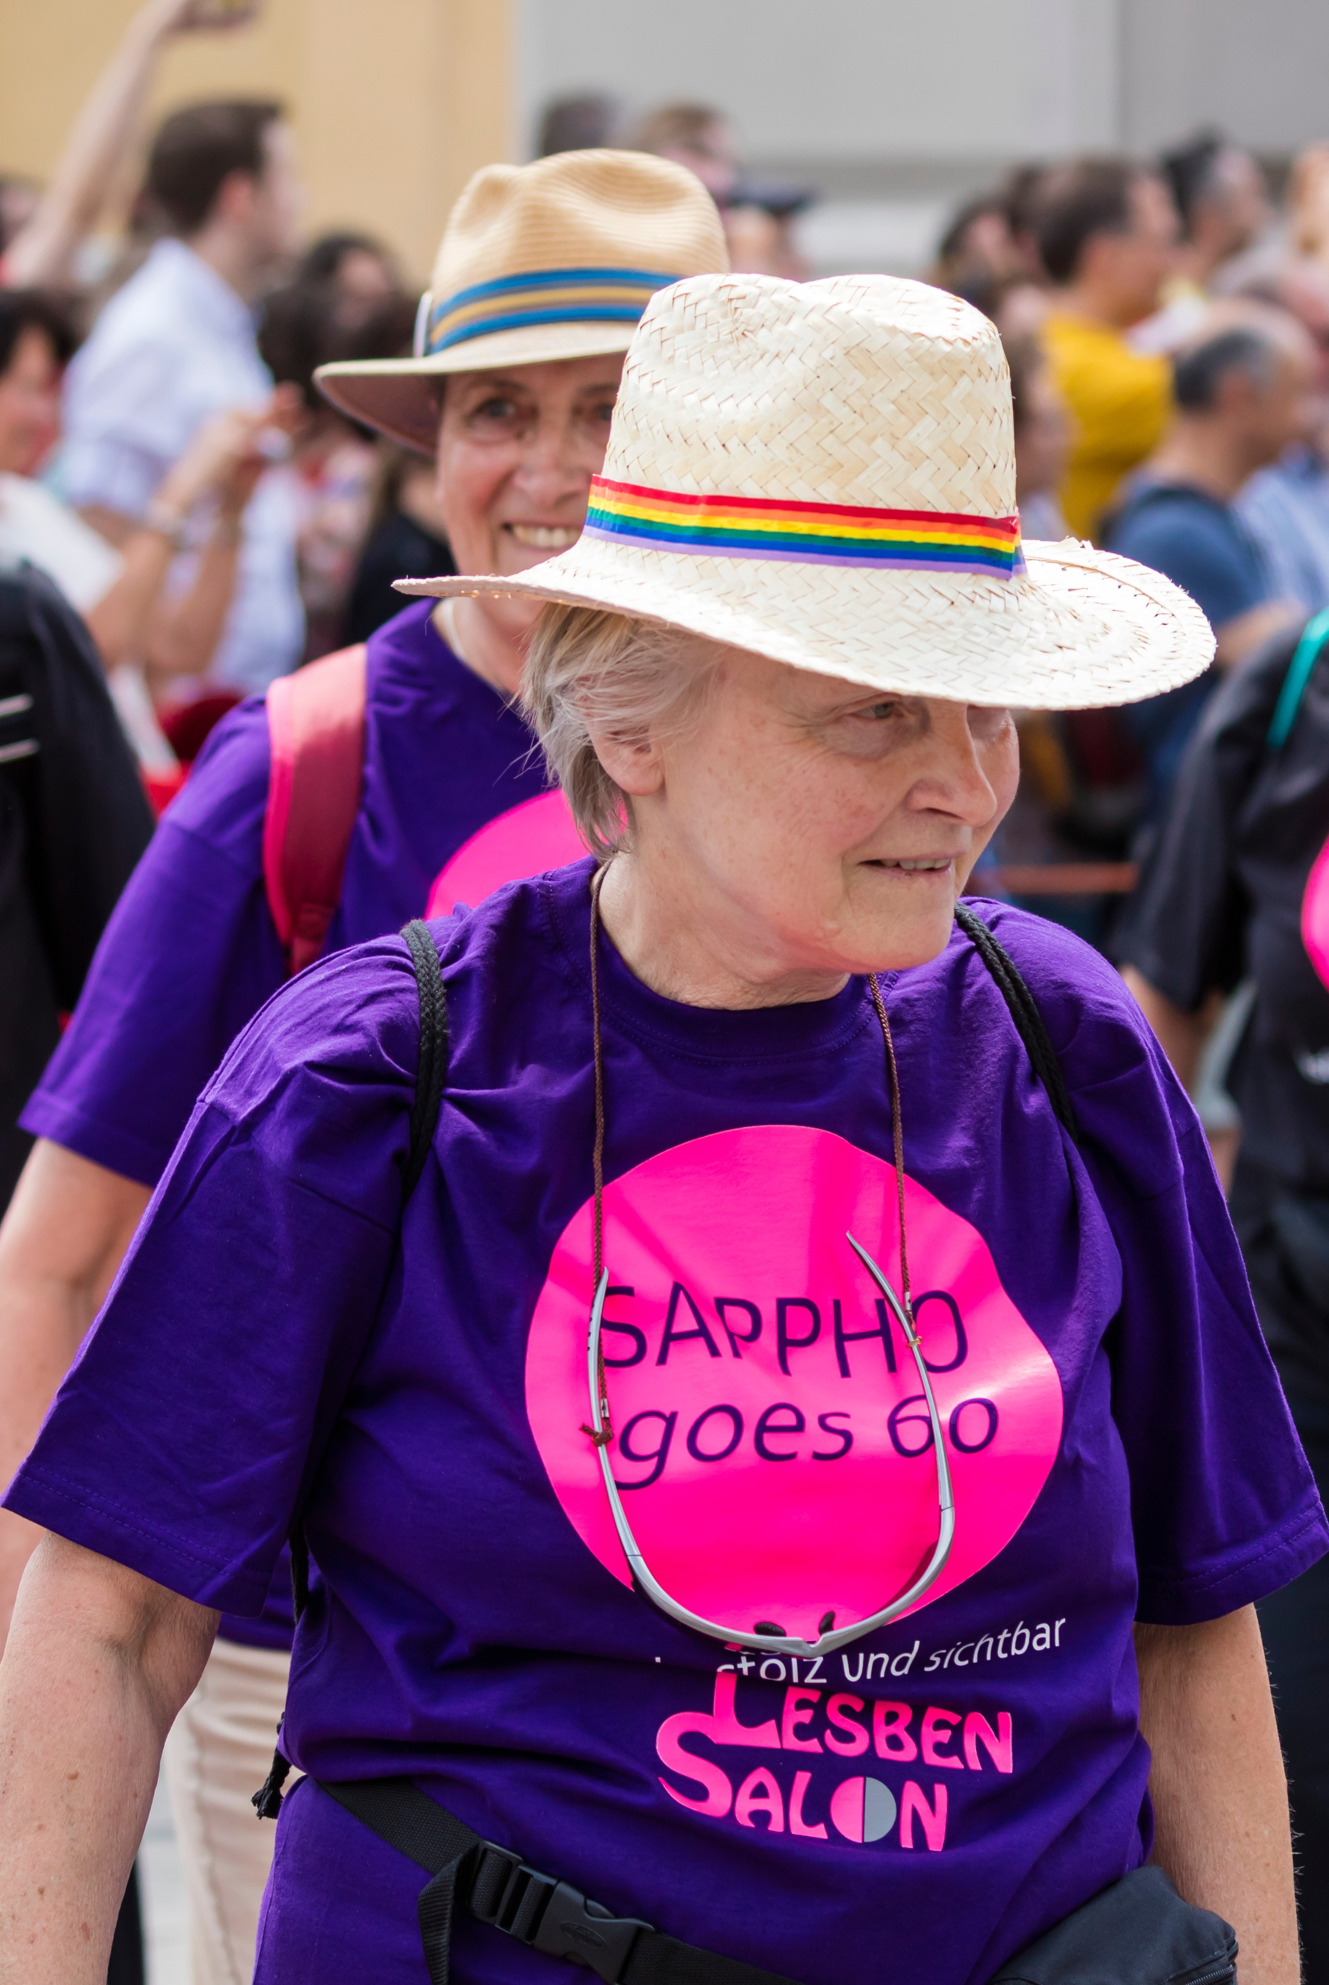
Gender diversity
Transgender, nonbinary, cisgender
Different perspectives on trans experience & language
Gender affirmation and euphoria
History of negative experiences with health care
Involvement of others in intimate care
Complex interplay of memory & gender expression

Slide 3
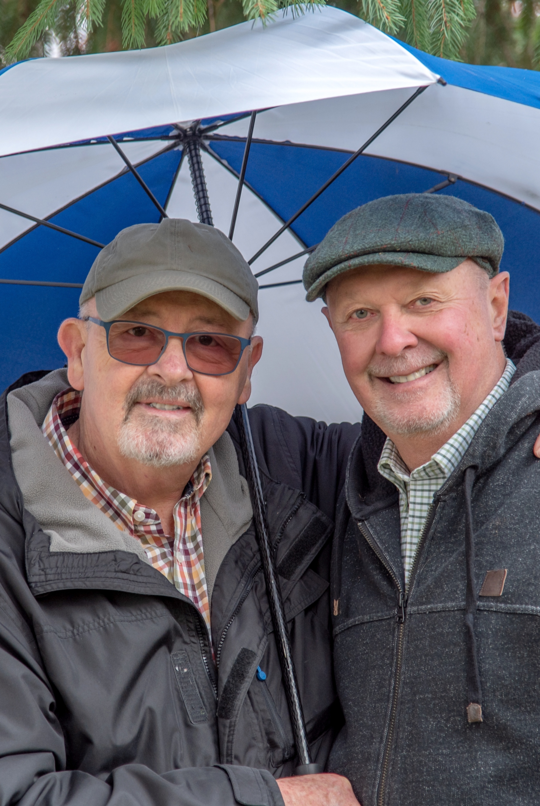
Sexual diversity
Attraction, behaviour, sense of self, community affiliation
Lesbian, gay, queer, bisexual, pansexual, asexual, heterosexual
Long term effects of discrimination – e.g. mental health
Implications of sexual disinhibition
Managing privacy & ‘remembering the fictions’

Slide 4
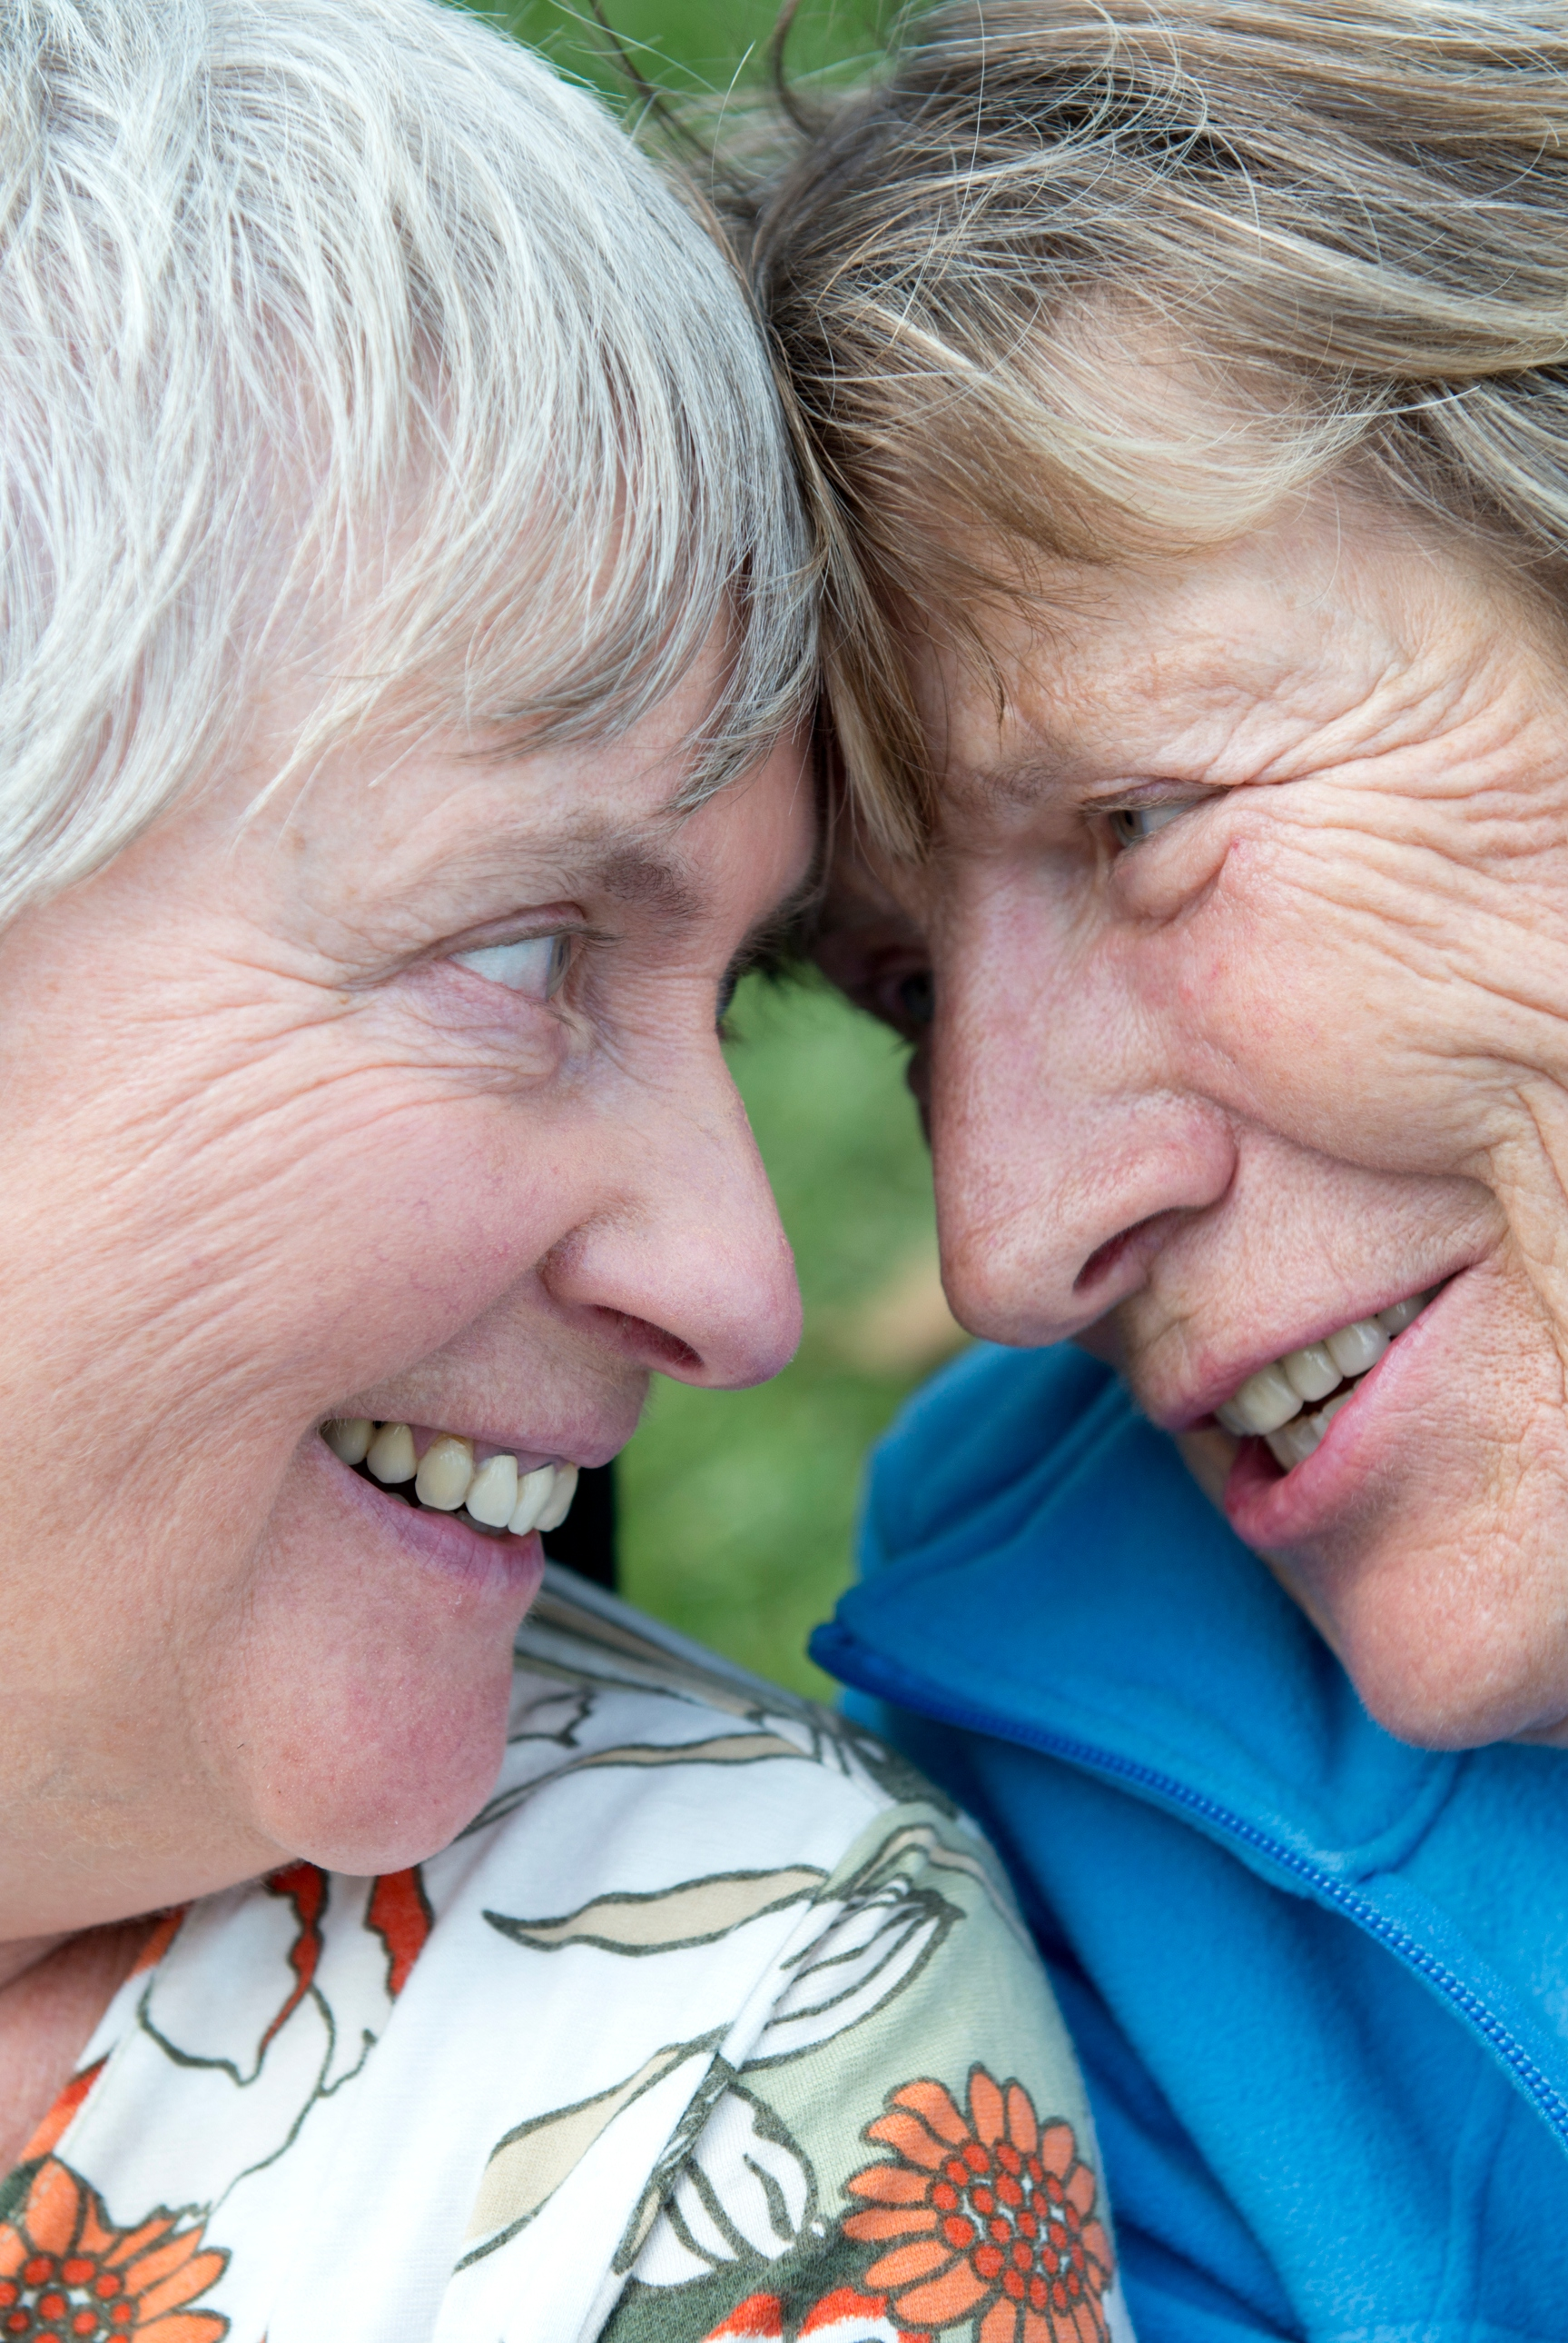
Caregiving
Contribution to caregiving & volunteering
Friendship networks & chosen families
Type & duration of care
Recognition & disenfranchised grief
Celebrate Ageing – Our Hearts are Bigger film
Anne & Edie’s experience

Slide 5
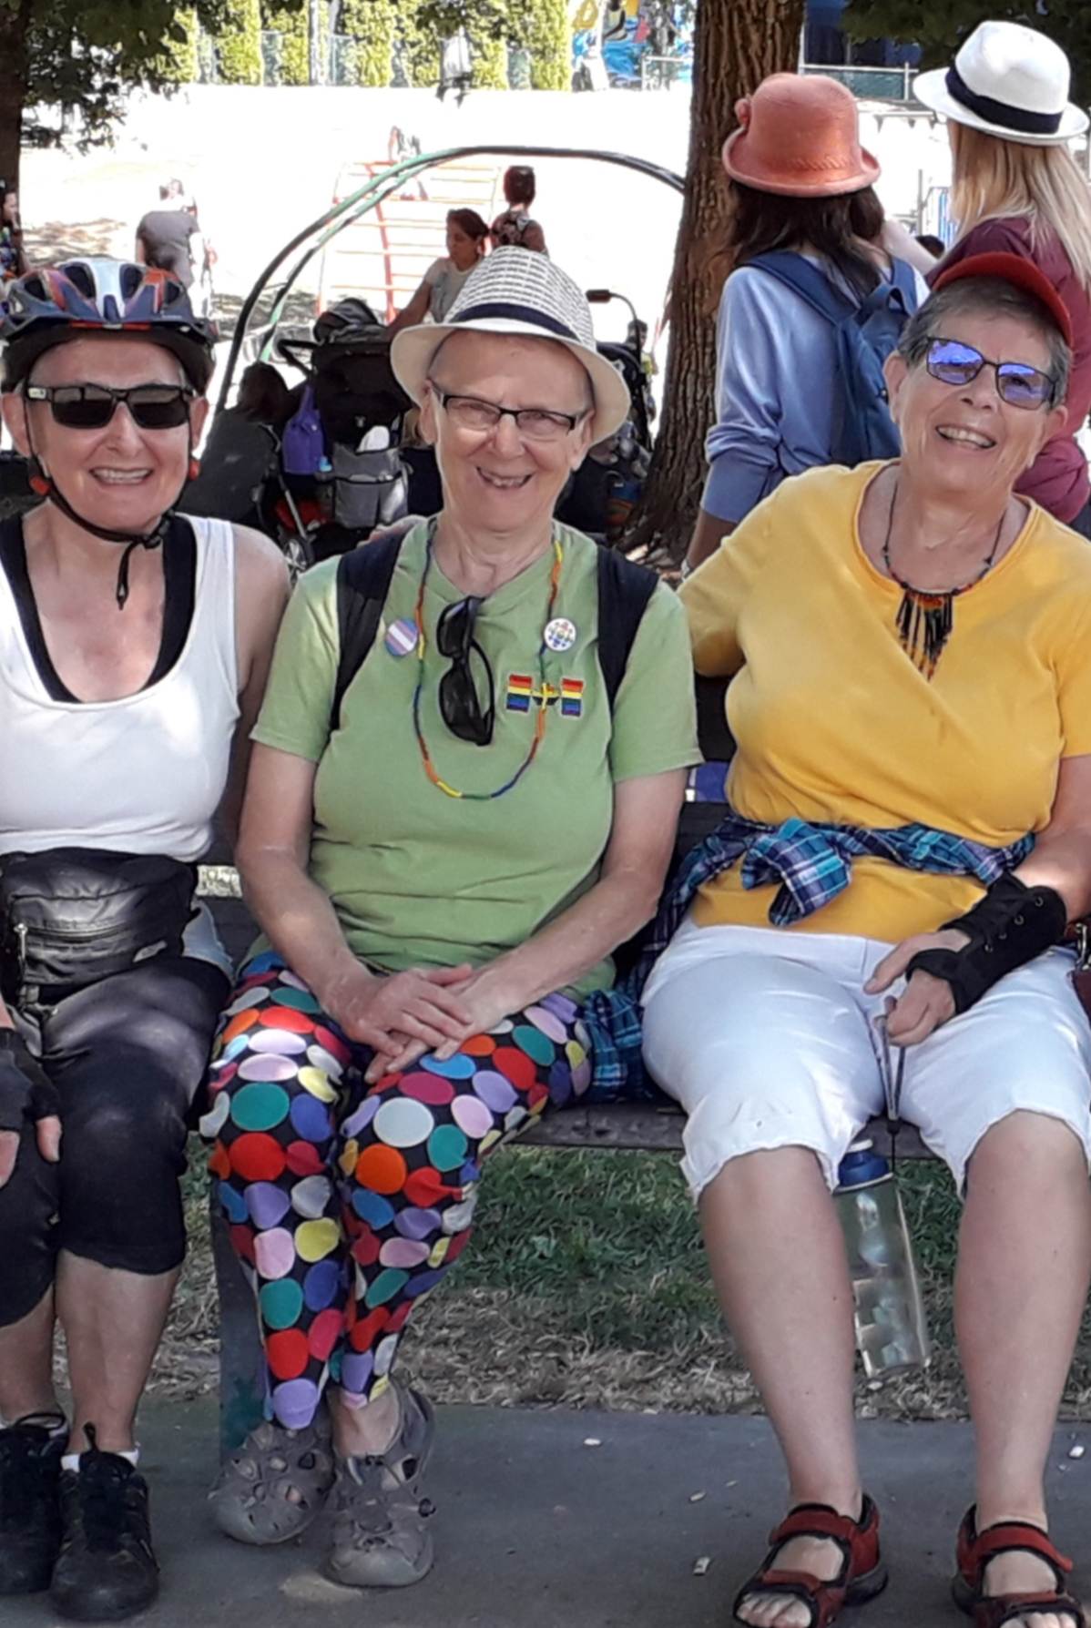
Advance care planning
Advance care directive, enduring power of attorney
Barriers similar to general population
But its protective effect important
Health professionals have responsibility to initiate conversation

Slide 6

Service delivery
Differences & intersections
Creating LGBTQ+ friendly/inclusive services
Whole of organisation culture change – e.g. Rainbow Tick
Responsibility to educate
Recognition of strengths & resilience
Codesign with LGBTQ+ people

Slide 7
Resources
Celebrate Ageing, Museum of Love, Letters of Love and Dementia
LGBTIQ+ Health Australia, Silver Rainbow program
ACON, LOVE project
Rainbow Health Australia, Rainbow Tick accreditation program
NSW Health, Advance care planning resources
Dementia Australia, LGBTI resources

Slide 8
Literature
Barrett, C., Crameri, P., Lambourne, S., Latham, J., & Whyte, C. (2015). Understanding the experiences and needs of lesbian, gay, bisexual and trans Australians living with dementia, and their partners. Australasian Journal on Ageing, 34(S2), 34-38.
Birch, H., 2009. Dementia, Lesbians and Gay Men. Melbourne: Alzheimer’s Australia.
Di Lorito, C., Bosco, A., Peel, E., Hinchliff, S., Dening, T., Calasanti, T., Cutler, N., Fredriksen-Goldsen, K., & Harwood, R. (2022). Are dementia services and support organisations meeting the needs of lesbian, gay, bisexual and transgender (LGBT) caregivers of LGBT people living with dementia? A scoping review of the literature. Aging & Mental Health, 26(1), 1912-1921.
Hughes, M. (2016) Providing responsive services to LGBT individuals with dementia. Chapter 6 in S. Westwood & E. Price (Eds.). Lesbian, Gay, Bisexual and Transgender (LGBT) Individuals with Dementia. London: Routledge.
Hsieh, N., Liu, H., & Lai, W. (2021). Elevated risk of cognitive impairment among older sexual minorities: Do health conditions, health behaviors, and social connections matter? Gerontologist, 61(3), 352-62.
Waling, A., Lyons, A., Alba, B., Minichiello, V., Barrett, C., Hughes, M., Fredriksen-Goldsen, K., Edmonds, S., & Bath, N. (2022) Experiences of informal caregiving among older lesbian and gay adults in Australia. Australasian Journal on Ageing, 41(3), 424-430.

