Slide 1
Disaster Planning

Slide 2
NSW Regions and Local Areas

Slide 3
State Emergency Management Plans
Natural Disasters – (Bushfire, Flood, Heatwave, Storm)
Energy and technology (Energy Supply)
Environmental (Hazardous Materials)
Transport and Infrastructure (Aviation, Major Structures)
Food and Biosecurity
Pandemic
Terrorism
Precincts and areas (Blue Mountains snow emergency)
Plans are based on Legislation (powers) and policy

Slide 4
Have a Plan Disaster Management Cycle
Mitigation – Includes Prevention
Preparedness
Response
Recovery

Slide 5
YOUR PLAN
Have an individual Plan should include the following considerations
How will I receive Emergency Alerts and Warnings
What is my housing plan
How will I evacuate and what route
How and I going to communicate with family/friends
What do I need if I have to evacuate
What will I do with my pets and anything left behind.

Slide 6
Evacuation - Emergency Go Bag Needs to be small and easy to carry
Documents (Insurance Currency Certificates, Passports, pet ownership including microchip details, Bank Account details, Wills)
Valuables (What is important to you)
Money
Medication
Change of Clothes
Water and food (small amount)
Phone and (spare battery)

Slide 7
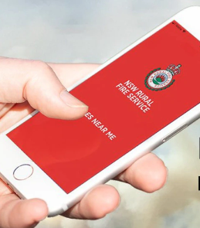
Requesting Assistance – Stay informed
000
Mobile App
Emergency Plus
Stay informed
Emergency Broadcasts
Fires Near Me

