Slide 1
Facing Adversity and Being Prepared
Dr Rachel Jones - Geriatrician

Slide 2
Acknowledgement to Country
I acknowledge the Traditional Custodians of the various lands on which we stand today and the Aboriginal and Torres Strait Islander people participating in this gathering.
I pay my respects to Elders past, present and emerging, and recognise and celebrate the diversity of Aboriginal peoples and their ongoing cultures and connections to the lands and waters of NSW.

Slide 3
Attention!
Apology in advance.
This presentation will discuss and display images from the recent Northern Rivers 2022 flooding events.

Slide 4
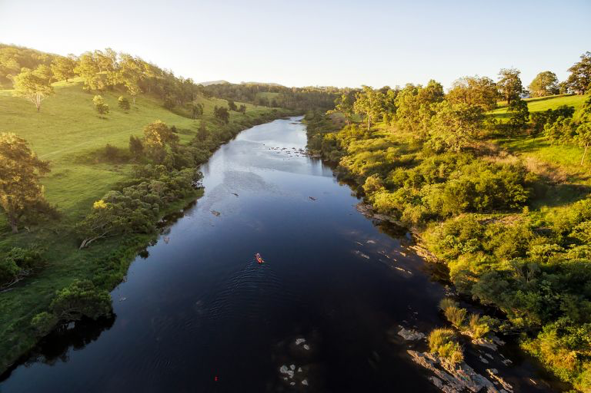

Slide 5
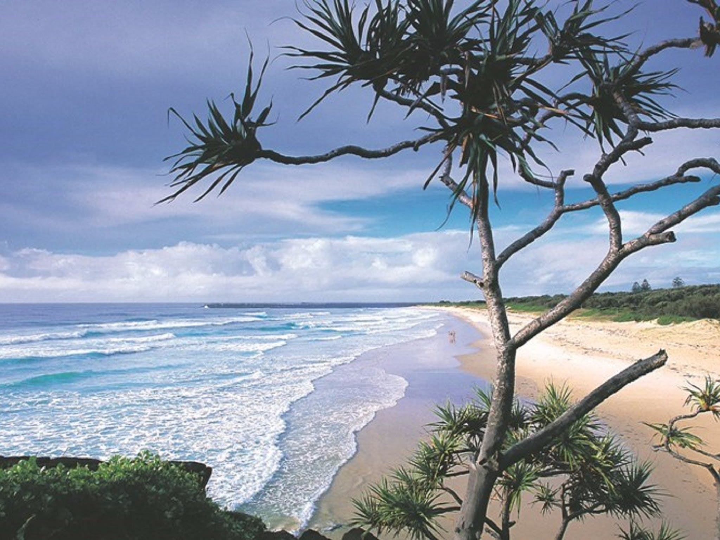

Slide 6
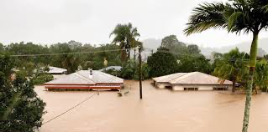
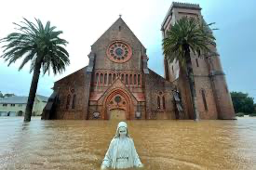
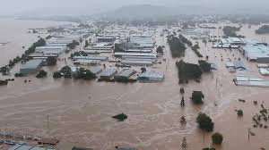
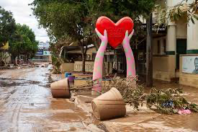

Slide 7
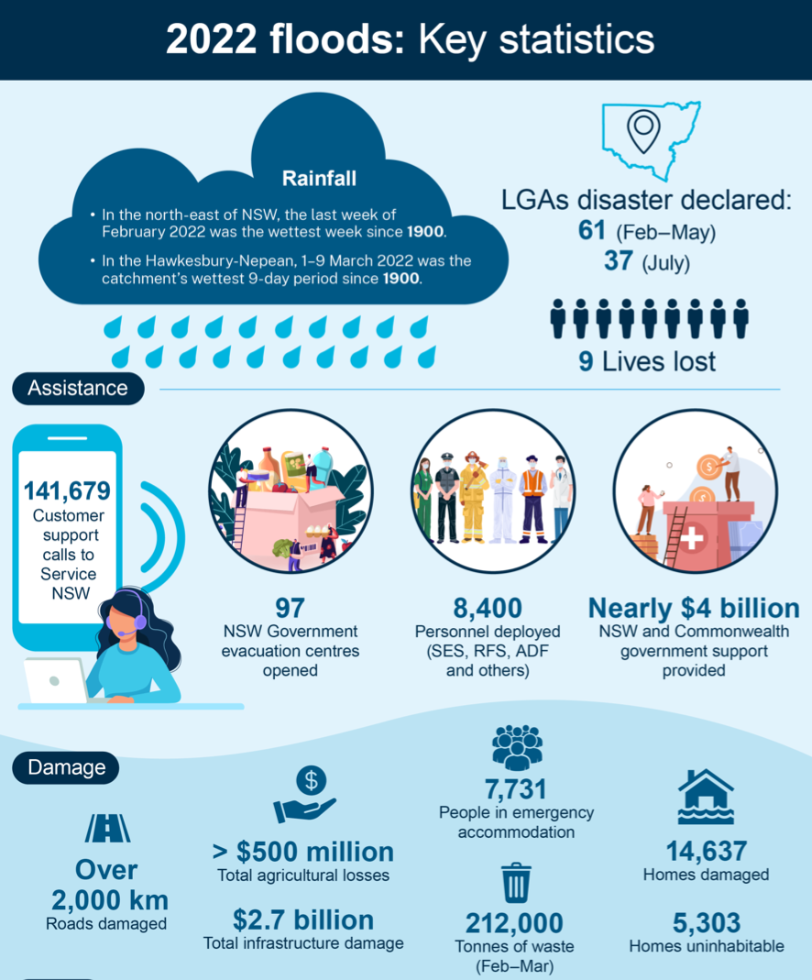
NSW Natural Disasters
Compounding disaster events experienced in recent years
2017 flood, 2019-2022 fires, 2021 floods, 2022 floods
NSW prone to natural disasters
2022 Flood Inquiry report released July 2022 acknowledging importance of disaster preparedness and resilience.
Impact of climate change
Intergovernmental Panel on Climate Change (IPCC) report released 28th Feb 2023

Slide 8
“Extreme rainfall is projected to become more intense (high confidence) but the magnitude of change is uncertain.”
“modelling studies project increases in flood magnitudes in northern and eastern Australia (high confidence).”
Climate risks are projected to increase for compounding impacts on settlements and infrastructure due to bushfires, floods, droughts, heatwaves, storms and sea-level rise.
Intergovernmental Panel on Climate Change (IPCC) report released 28th Feb 2023

Slide 9
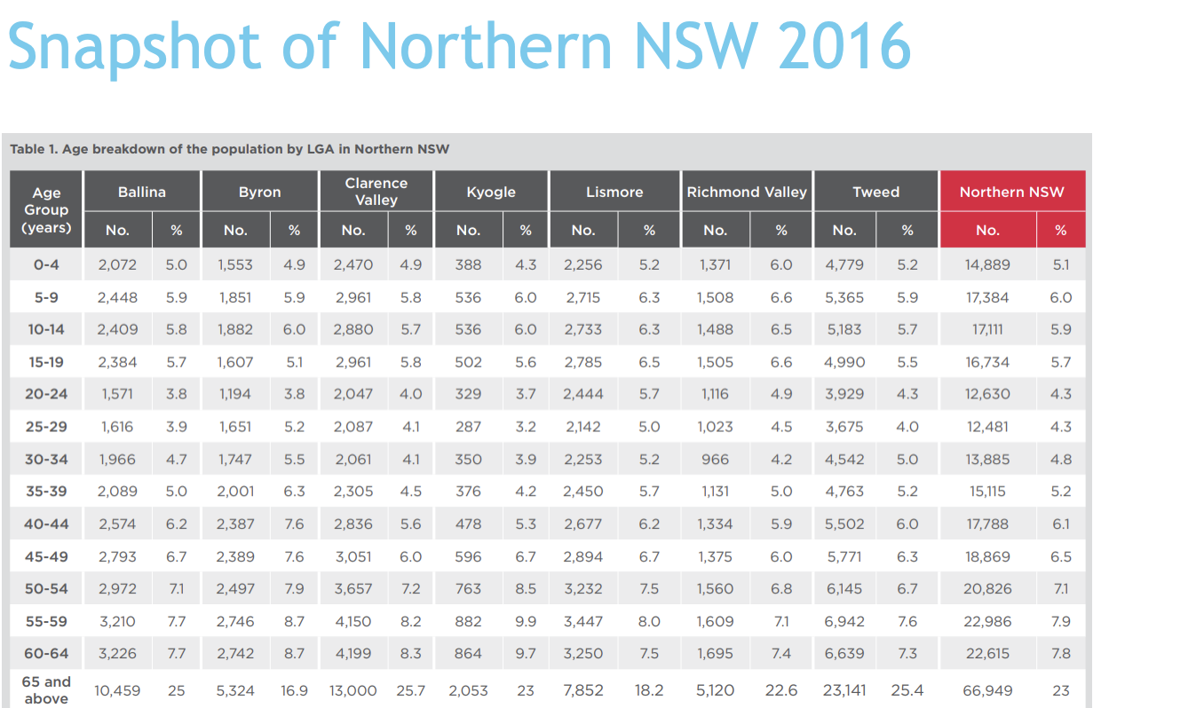
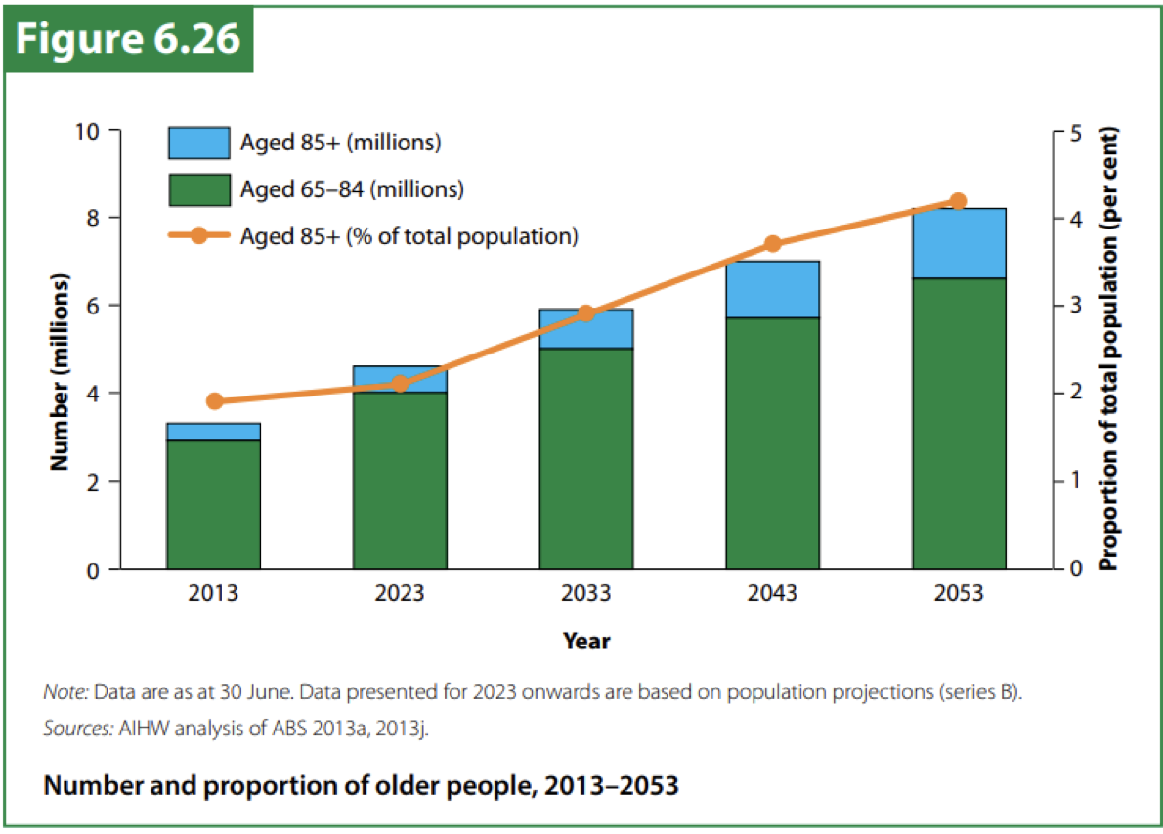
Population statistics

Slide 10
Population statistics
How common is dementia?
84 people living with dementia per 1000 Australians aged 65 and over
Northern Rivers → 77 635 people aged 65 years and over (2021)
~ 6521 people living with dementia (2021)
~ 800 000 Australians will live with dementia by 2058!

Slide 11
Why is this relevant to you?

Slide 12
Case study
70 yo retired nurse, living in West Ballina with her long-term partner.
Background history of anxiety which has limited presentation for assessment since 2019 when concerns were emerging.
Diagnosed with Alzheimer’s disease in February 2022 and in the process of establishing a treatment plan with Geriatrician.
Planned for review in 3 months after further investigations planned.
MARCH 2022 - the couple's home was directly flood impacted.

Slide 13
Case study
Moved around emergency short term accommodation across the region - including small motel rooms (5x moves in 2 months).
Long term accommodation search began.
Cognitive / emotional and behavioral changes
Increasingly confused, disorientated, anxious, hostile towards partner.
Declining mobility, near falls.
Refusing oral medications and personal care.
Escalating carer stress.
Difficulties obtaining home care package support / supplemental meals.
Transitioned to permanent residential care within months.

Slide 14
Reflections
Managing carer related grief / loss, whilst supporting someone living with dementia.
Managing behavioural and psychological symptoms of dementia.
Difficulties in communication and accessibility to dementia specific services.
Limited dementia - friendly accommodation.
Self-care for the carer themselves.
Compounding grief / loss / guilt and the transition into permanent care.
Emerging mental health issues.

Slide 15
Consequences of Natural Disasters
Psychological
Emergency induced distress / grief
Anxiety / depressed mood / acute stress disorder / PTSD
BPSD exacerbation - anger, agitation, distress, withdrawn, disorientation
Physical challenges
Change in routine
Loss of accommodation and possessions / communication issues
Loss of resources / local formal supports / isolation from family and friends
Difficulty accessing health services / supplies
Abuse / neglect

Slide 16
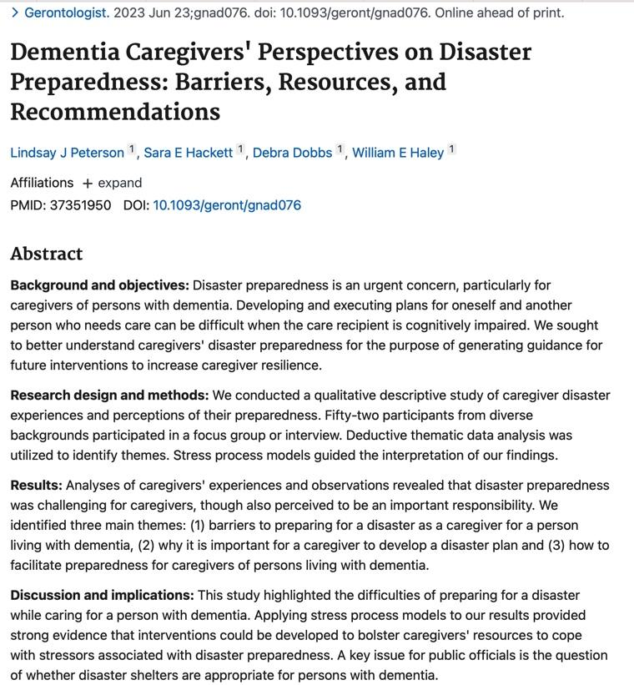

Slide 17
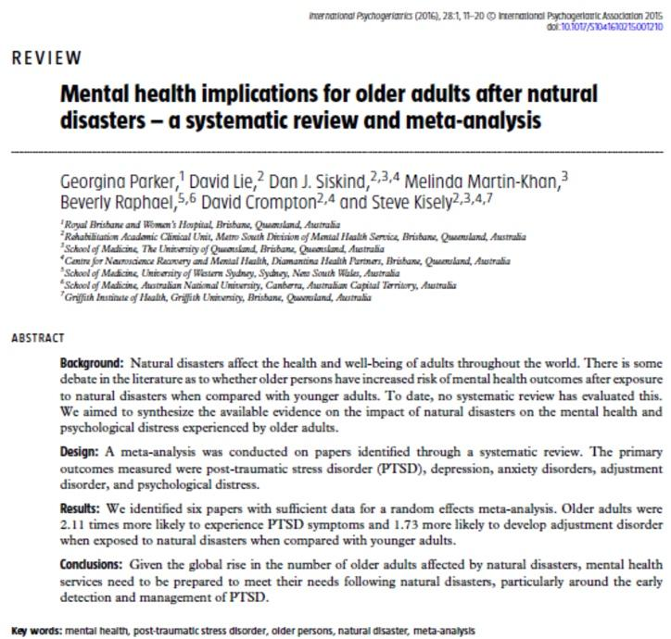

Slide 18
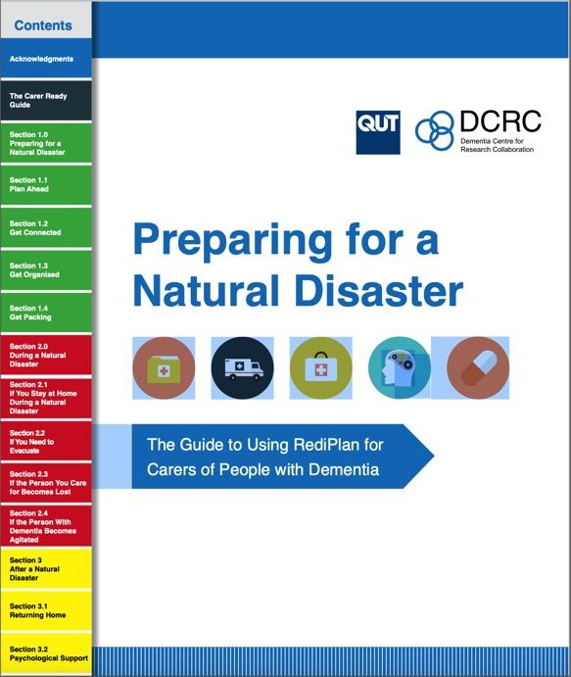
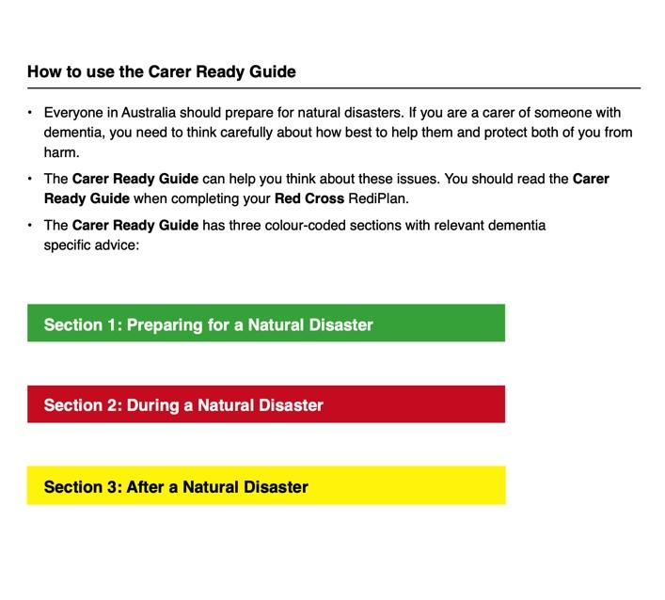

Slide 19
Preparedness, Preparedness, Preparedness
PLAN AHEAD
Best escape plans / evacuation routes of transport
Alternative accommodation / evacuation centres
Consider how person living with dementia may cope during / after natural disaster to facilitate a level of control

Slide 20
Preparedness, Preparedness, Preparedness
GET CONNECTED
Identify a support network - family, friends, neighbours, community / carer groups, professionals or volunteers
Include several people that the person with dementia spends time - ensure emergency plan is shared
GP, Dementia Outreach Service, Home Care Package case manager, Carer Gateway
Sign up to Safely Home Program - call National Dementia Helpline (1800 100 500)
Sign up to MedicAlert - call the MedicAlert Foundation Helpline (1800 882 222)

Slide 21
Preparedness, Preparedness, Preparedness
GET ORGANISED
In RediPlan write down specific needs of person living with dementia
Likes / dislikes, routines, care needs
Mobility needs
BPSD management - ie. strategies to manage anxiety / agitation
Hearing / communication needs
Other needs: diet, continence aids, medical history, meds etc.
Important contact details e.g. emergency contacts, out-of-town contacts, doctor, pharmacist, out-of-hours services
Current photo
Keep up to date, discuss with GP / pharmacist. SHARE

Slide 22
Preparedness in dementia
Dementia is a chronic disease and should be managed as such
Collaborative relationship with treating team
General Practitioner
Pharmacist
non-GP Specialist (e.g. Geriatrician, Geriatric Psychiatrist, Neurologist)
Psychogeriatric Nurse Practitioner
Allied health as required e.g. physiotherapy, occupational therapy

Slide 23
Lastly… or most importantly
STAY CONNECTED!
Develop social / support networks
Friends / family / neighbours
Dementia Outreach Service / Dementia Inclusive Ballina / Parkinson’s support groups or Parkinson’s nurses / Older Persons Mental Health Service
Dementia Australia website / Dementia Support Australia / Carer Gateway
Beating Hearts of Lismore / Day Respite groups
Link with My Aged Care / ACAT / DVA / NDIS

Slide 24
Lastly …. or most importantly
Optimise your psychological, physical and cognitive health
STAY ACTIVE and consume a well-balanced diet
Engage in social activities
Optimise sleep, limit alcohol, optimise vascular health with GP
Review medications with GP
Monitor signs of depression / anxiety
Engage in Music Therapy, Cognitive Behavioural Therapy etc.
Driving
Advance Care Planning
Legal matters - EPOA / EPOG / Will - EARLY

Slide 25
Rementia Together 5-day retreat
Provides people with dementia and their support partner hope beyond diagnosis.
5 day, live-in retreat accommodates five people / their support partners
Provides innovative dementia education
Shares tools and strategies to help you live well
Connects you with others
Funded by Australian Government and led by Group Homes Australia
How to access?
Register interest online: https://grouphomes.com.au/5-day-retreat/

Slide 26
