Slide 1
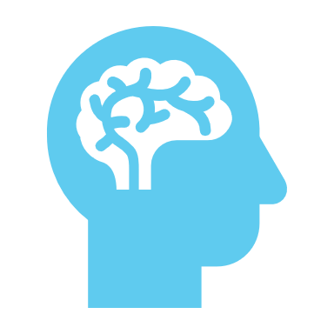
Dementia Update and a little about me…
Dr Rachel Jones - Geriatrician

Slide 2
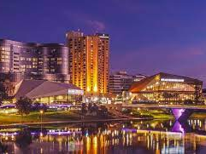
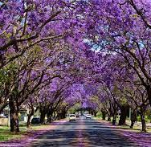
Who am I?
Rachel Jones
Born and bred in Grafton, NSW
Moved to Adelaide, pursued Bachelor of Surgery, Bachelor of Medicine at University of Adelaide
Pursued physicians training and subspecialised in Geriatric Medicine across various South Australian Hospitals + Alice Springs Hospital
Completed a Fellowship for the Royal Australasian College of Physicians – Geriatric Medicine
Member of the Australian and New Zealand Society for Geriatric Medicine

Slide 3
More importantly…
Married a South Australian plumber / gas fitter
Had two beautiful children in 2016 and 2019
Returned back home to be closer to family in Lismore in early 2021
Husband has set up a plumbing and gas fitting business locally
Dr Hugh Fairfull-Smith retired and I shuffled into his office

Slide 4
Where do I work?
Northern NSW Local Health District
Public appointed Geriatrician – work 4 days per week
Clinics: Ballina District Hospital, The Carroll Centre (Lismore), Casino District Hospital
Provide outreach support to peripheral sites as required – Bonalbo, Kyogle, Nimbin etc
Support GP’s and RACF sites
Perform Geriatric consults to hospitals within our local network
Run a weekly Geriatric teaching program for multidisciplinary staff at Lismore Base Hospital

Slide 5
What is a Geriatrician? What is Geriatric Medicine?

Slide 6
Geriatric Medicine / Geriatrician
Medical specialist / physician trained in geriatric medicine
Wholistic approach
Manage older people with often complex medical issues
Diagnose and manage “geriatric syndromes”
Cognitive impairment e.g. dementia, delirium
Polypharmacy
Falls
Incontinence
Functional impairment
Frailty …..
Multidisciplinary - nursing, allied health and other medical professionals e.g. GP

Slide 7
How do we define ‘old’?
Population measurement = ‘old’
‘old’ is conventionally defined as people aged 65 years and over (based on the original qualifying age for the Age Pension)
IMPORTANT: a person does not necessarily become frail or ‘dependent’ at age 65 (or at any other particular age).
Complex and diverse older Australian population
Variation of health, economic and social circumstances impacting each person
Don’t be offended if you see me because you are aged > 65 years

Slide 8
Ageing community
Australia’s population is ageing and evidence for this demographic change is undeniable
Past falls in fertility, increasing life expectancy, effect of ‘baby boomer’ generation
Major growth in number and proportion of people aged over 65 years
Trend will continue to grow over the coming decades.
Aged > 65 years: 2.5 million in 2004, 3.3 million in 2013, over 8.3 million by 2053
Prediction in 2004: people aged over 85 years will grow 1.4% to 6% by 2051

Slide 9
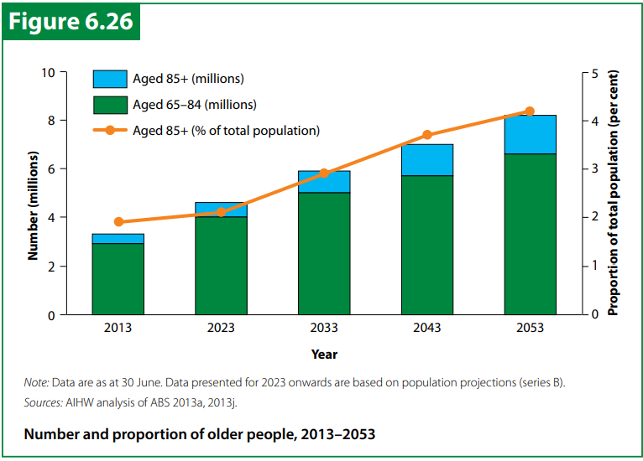

Slide 10
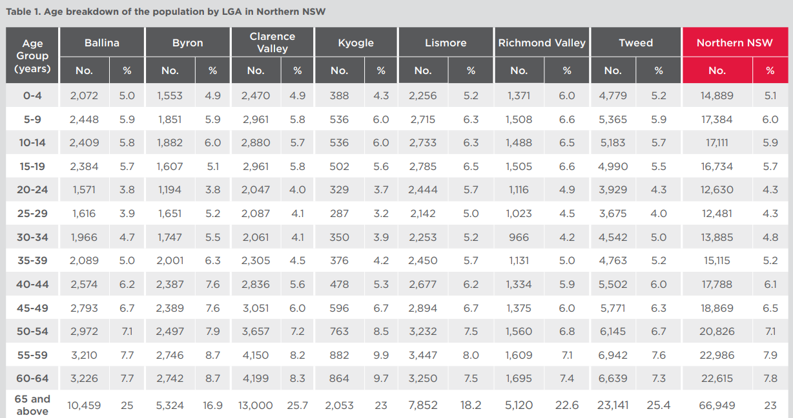
Snapshot of Northern NSW 2016

Slide 11
Snapshot of Ballina 2021
Our region is growing rapidly
‘Seachange phenomenon’ – older and younger flocking to regional areas – lifestyle, financial and property benefits
Working from home during COVID

Slide 12
The future – what response can we have to ageing?
Promoting good health across the lifespan
Ageing IS associated with an increased risk of:
Chronic health conditions
Disability
Functional decline
BUT!!!
Research indicates that many chronic conditions are preventable (or can be postponed) and are NOT inevitable

Slide 13
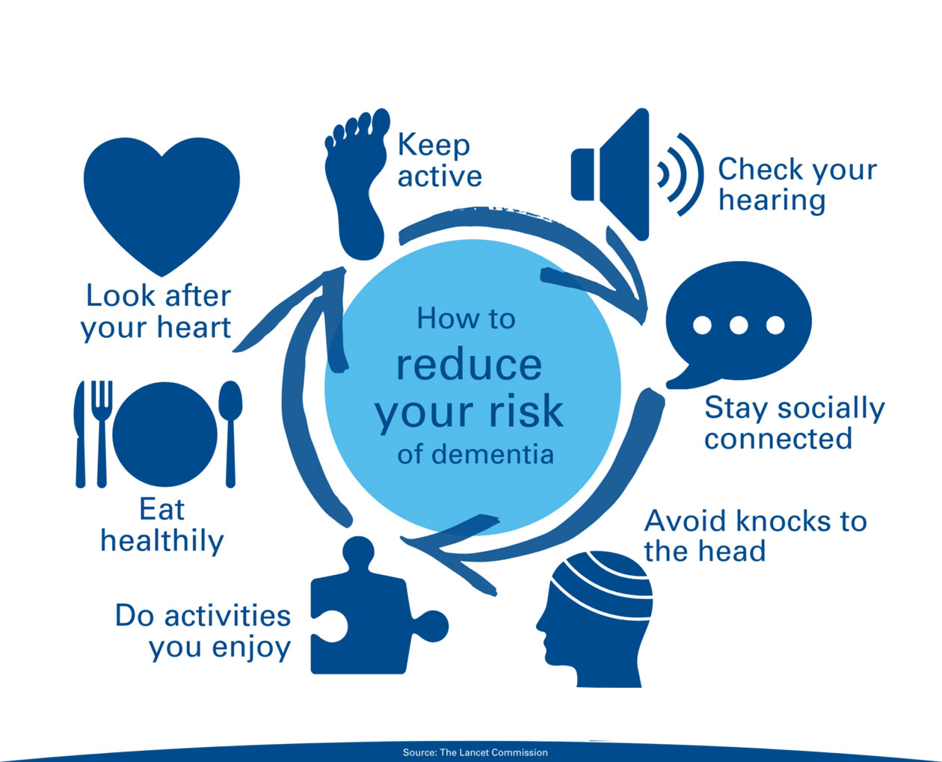

Slide 14
Lets break that down...
Bring brain healthy is relevant at any age, young or old – VERY important once you reach middle age
Risk factors you can’t control (non-modifiable)
Age
Genetics
Family history
Risk factors you CAN control (modifiable)
Heart health
Body health
Mind health

Slide 15
Reducing risk of dementia
Heart health = brain health
Cholesterol
Blood pressure
Diabetes mellitus
Obesity
Above not only increase risk of heart attack / stroke BUT also dementia
Book GP check-ups for blood pressure, blood glucose levels and cholesterol levels
Eat a healthy diet
Stop smoking

Slide 16
Reducing risk of dementia
Avoid knocks to the head
Significant head injuries or repeated head injuries, can increase the risk of dementia
Keep physically active
Sedentary lifestyle with little physical activity is associated with increased risk of dementia
Recommendation: regular exercise – aerobic activities such as walking / cycling OR strength training
Eat healthy
Avoid processed foods
Eat lots of fruits and green leafy vegetables
Mediterranean style has proven benefits for brain health

Slide 17
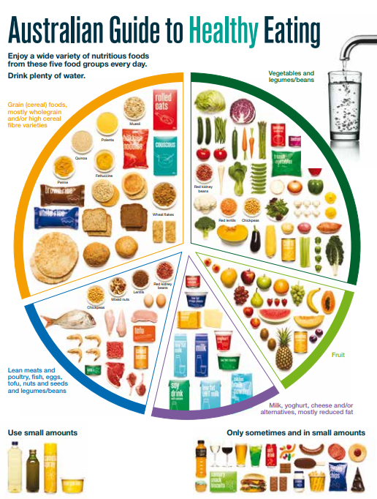

Slide 18
Reducing risk of dementia
Keep your brain active
Socialisation with friends and family, Men’s Shed, Volunteering Australia
Learn a second language OR musical instrument
Crosswords, Sudoku, other puzzles
Reading, painting, sewing, woodwork, cooking, technology
Check hearing and other senses
Senses impact the way we respond to our environment and people
Link between hearing and vision loss and risk of developing cognitive problems later in life

Slide 19
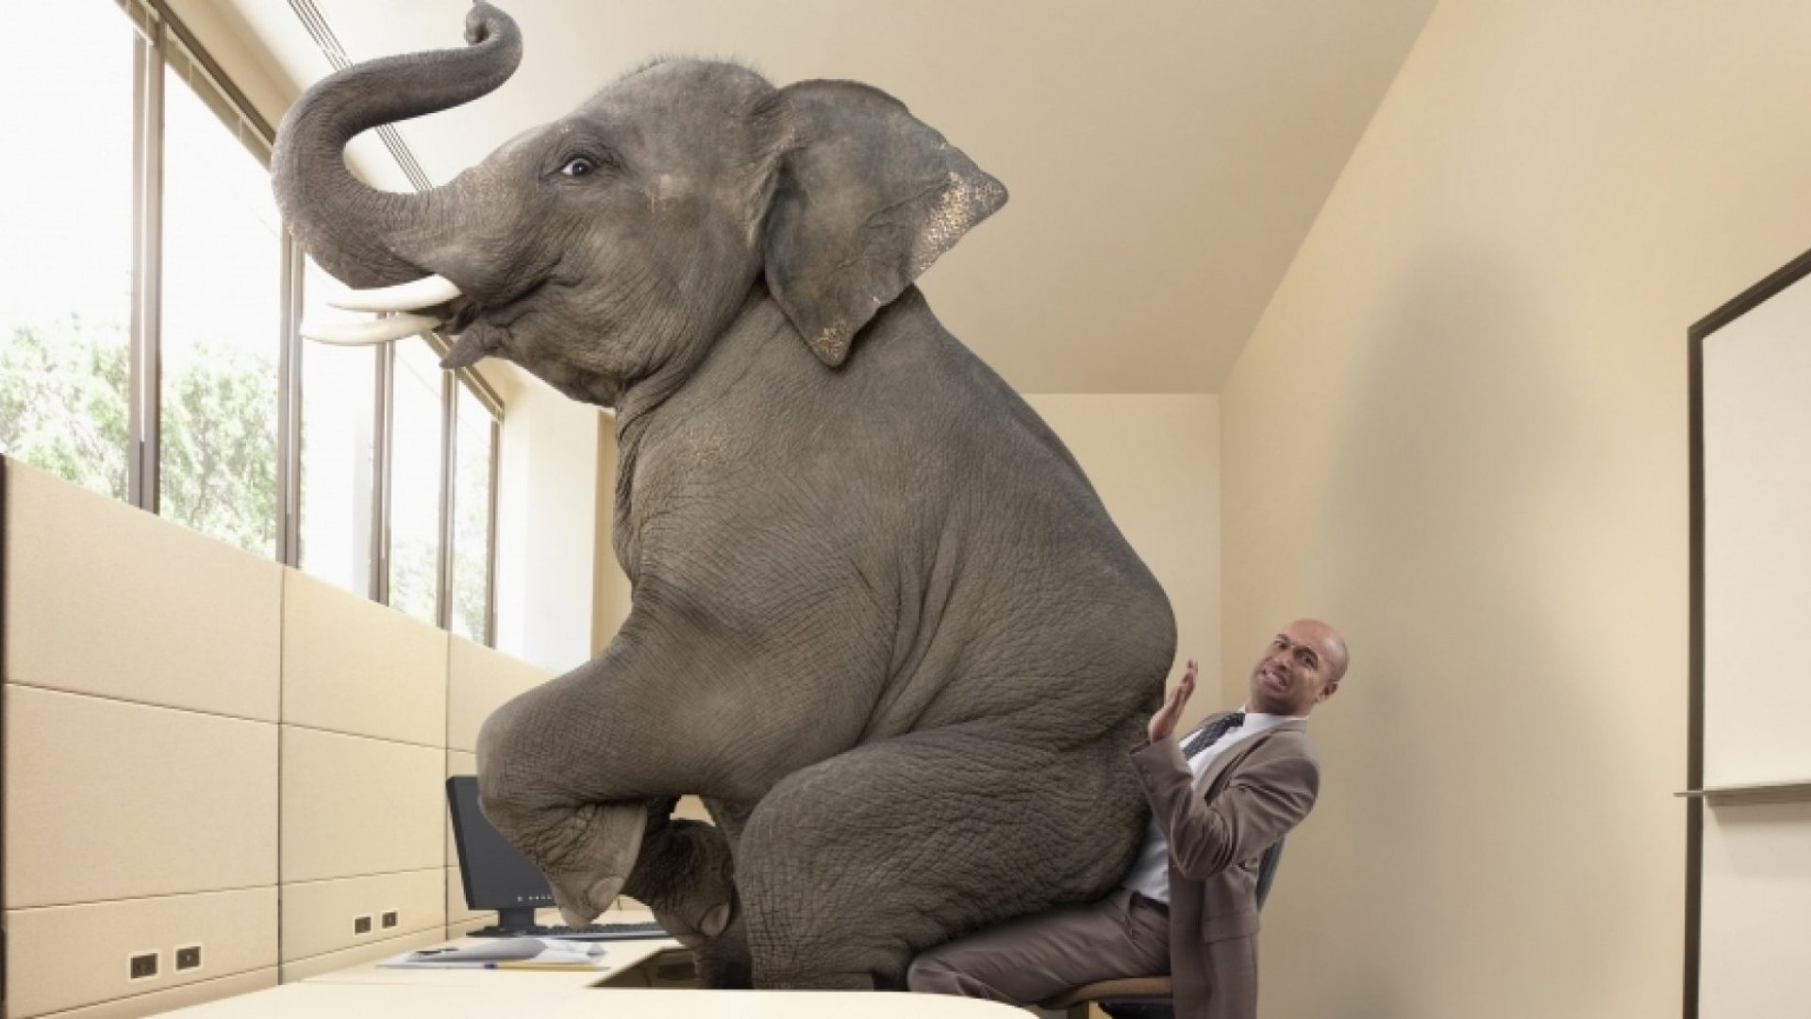

Slide 20
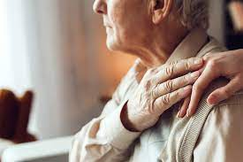
DEMENTIA

Slide 21
Is memory loss expected with ageing?
Firstly…. Dementia is NOT a normal part of ageing
Common complaints which CAN be normal
Forgetting names, losing things, forgetting directions, forgetting appointments, changes in mood and personality
Factors that can impact memory or thinking:
Tired, dehydrated
Stress, grief, pain or anxiety
Medications
Infections, acute illness, nutrient deficiencies
Depression
Hormone changes
Sensory impairment – vision / hearing

Slide 22
When should I seek review?
Difficulties recalling the day / date
Trouble remembering recent events / conversations
Difficulty performing day to day activities
Difficulty following and joining conversations, especially in group settings
Losing interest in activities which once were enjoyed
SEE YOUR GP!
DEMENTIA AUSTRALIA WEBSITE – dementia.org.au
NATIONAL DEMENTIA HELPLINE 1800 100 500

Slide 23
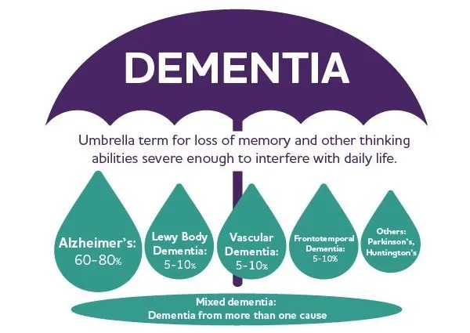
What is dementia?

Slide 24
Who gets dementia?
Dementia is the second leading cause of death in Australians
Leading cause of death for women
In 2022, ~487 500 Australians living with dementia → 1.1 million by 2058.
In 2022, 1.6 million Australians care of someone living with dementia
65% people with dementia live in the community

Slide 25
Signs and symptoms of dementia
Memory loss
Changes in planning / problem solving abilities
Misplacing things and losing ability to retract steps
Difficulty completing tasks
Disorientation in time and / or place
Difficulty interpreting objects / people and distances / depth / space
Difficulty with speech, writing, comprehension
Impaired judgement
Withdrawal from work or social activities
Change in mood / behaviour / personality

Slide 26
Diagnosing dementia
Consult a doctor or nurse practitioner (in certain practices) early
In certain circumstances, a Geriatrician / Neurologist / Psychiatrist referral is performed
Clinical diagnosis – history / examination / investigations / cognitive testing
Detailed history
Thorough physical examination
Blood tests and / or urine test
Specialised tests (in certain settings): CXR, ECG, brain scan (CT/MRI/PET)
Memory testing – e.g. mini-mental status examination (MMSE)
On occasions – neuropsychological assessment requested

Slide 27
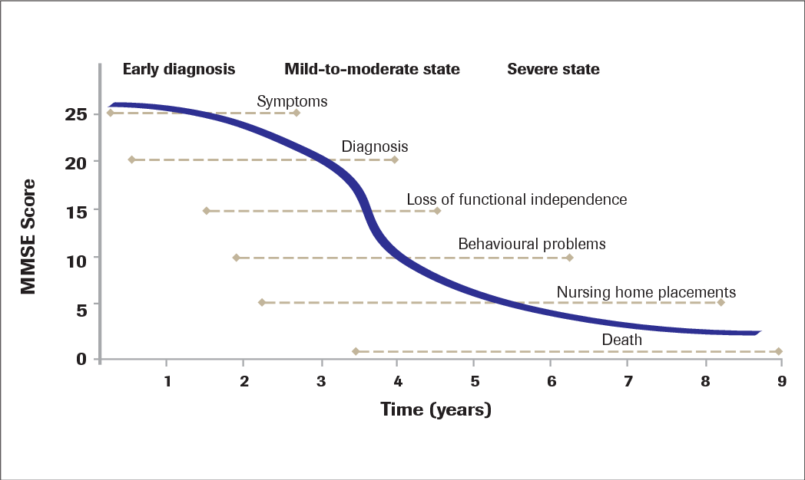
Natural history of dementia

Slide 28
Behavioural and psychological symptoms of dementia (BPSD)
Integral manifestation of dementia
Common in the intermediate stages of Alzheimer’s disease and at various stages in other types of dementia
Clinical features:
Aggression
Agitation
Anxiety
Apathy
Depression
Disinhibited behaviours
Nocturnal disruption
Psychotic symptoms
Vocally disruptive behaviours
Wandering

Slide 29
Non-pharmacological Treatment
Exercise
Regular daily walk or regular exercise program – improves physical functioning, cognition (mild cognitive impairment), slow functional decline, reduce risk of falls
Nutrition
Well-balanced, at least three meals per day, plenty of water, snacks, pre-made frozen meals or meal preparation through HCP
Limit alcohol – e.g. one drink per sitting and avoid after dinner (sleep impacts)
Cognitive rehabilitation – cognitive stimulation (e.g. socialisation / day respite options, puzzles, sudoku, tablet)
Strategies to assist declining function (e.g. aids, alarm, calendar, sticky notes, Webster pack)

Slide 30
Non-pharmacological Treatment
Advance care planning
Advance Care Directive, Enduring Power of Attorney / Enduring Power of Guardian
Decision making capacity
Safety issues
Driving
Falls
Behavioural disturbances
Wandering
Home safety
SUPPORT CAREGIVERS – further information later
Alternate – light massage, aromatherapy, music and dance therapy, animal assisted therapy, multi-sensory therapy

Slide 31
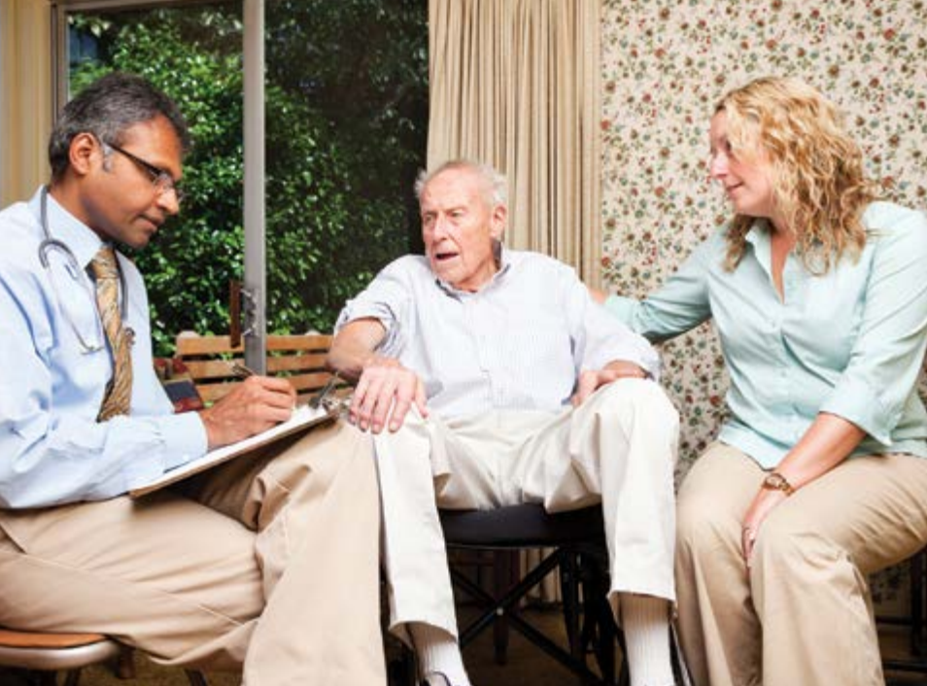
acd-form-info-book.pdf (nsw.gov.au)

Slide 32
Pharmacological Treatment
No disease modifying agents / No cure
Vascular risk factor optimisation– e.g. blood pressure, cholesterol, diabetes, blood thinners, smoking cessation
Minimise polypharmacy – risk of adverse effects, anticholinergics, benzodiazepines, opioids, antipsychotic medications
Specific therapies
Cholinesterase inhibitors – donepezil, rivastigmine, galantamine
Memantine
(Aducanumab)
Antipsychotic medication
Optimise pain and sleep – heat packs, physiotherapy / massage, paracetamol, melatonin

Slide 33
Where to find out more information?
Your local health care professional – GP, practice nurse or nurse practitioner
Dementia Australia Website – help sheets
National Dementia Helpline 1800 100 500
Dementia Outreach Service
My Aged Care
Carers Gateway – 1800 422 737 or carergateway.org.au
Dementia Behavioural Management Advisory Service (DBMAS)
Talk with other carers who may have experienced similar situations

Slide 35
Forget Me Nots – Grafton - soon to be ‘Beating Hearts of Lismore’
Community music / singing and movement group in Grafton
Established 5 years ago by Leigh Robertson and Jenny Worrell
Collaboration with the Clarence Valley Conservatorium and The Bendigo Community
No inclusion or exclusion criteria – targets older people living in the community – socially isolated, cognitive impairment, movement disorders, anyone that wants a fun weekly outing (morning tea provided)!
30-40+ attendees each week, 1.5 hours
Thoroughly enjoyed by attendees, their spouses / carers / significant others
Benefits in behaviours, mood, cognition, function strongly evident

Slide 37
References
Ageing and the health system: challenges, opportunities and adaptions. Chapter 6 – Health through your life; Australia’s health 2014). AIHW. Available at: AIHW.gov.au
Australian Bureau of Statistics. 2021 Census All persons QuickStats. Ballina. Available at: abs.gov.au
Australia’s ageing population. Economic implications for local government. Australian Local Government Association. September 2004. Available at: pc.gov.au
Northern NSW District Data Profile. NSW Government.
Information for the Public. Australia and New Zealand Society for Geriatric Medicine. Available at: anzsgm.org
Lismore – Come to the Heart. Available at: cometotheheart.com.au

Slide 38
References
Alzheimer’s New Zealand. Reducing the risk. Available at: alzheimers.org.au

