Slide 1


Situating people with dementia and their carers in the research, policy and practice nexus
Dr Claudia Meyer
Senior Research Fellow, Bolton Clarke Research Institute
President, Australian Association of Gerontology

Slide 2
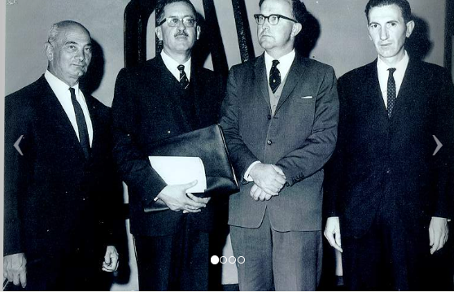
AAG – Who are we?
Gerontology is the study of ageing and older adults
Independent and impartial Australian organisation with the purpose of improving the experience of ageing by connecting research, policy and practice
AAG foundations were laid in 1962
Notes:
Broadly, gerontology is the study of ageing and older adults – it’s multi-disciplinary, and considers the physical, mental and social aspects and implications of ageing
We are the only independent and impartial organisation in Australia whose purpose is to improve the experience of ageing by connecting research, policy and practice
AAG foundations were laid in 1962, with the first conference held in Canberra in 1964

Slide 3
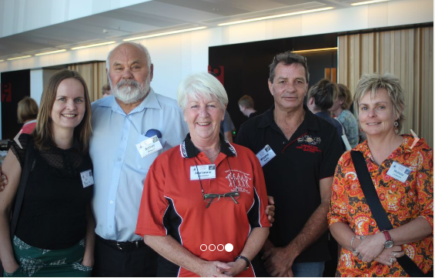
AAG – Who are we?
~ 1300 members across every State and Territory in Australia, including 130 organisational members
International Association of Gerontology and Geriatrics and the International Longevity Centre – Global Alliance
Special Interest Groups, Collaborating Research Centres, and the Aboriginal and Torres Strait Islander Ageing Advisory Group (ATSIAAG)
Notes:
Today, we have almost 1300 members across every State and Territory in Australia, including 130 organisational members
We have strong international connections through the International Association of Gerontology and Geriatrics and the International Longevity Centre – Global Alliance
We convene Special Interest Groups, bring together Collaborating Research Centres, and facilitate the Aboriginal and Torres Strait Islander Ageing Advisory Group (ATSIAAG)

Slide 4
AAG - at the nexus
AAG members include researchers, aged care professionals, geriatricians, nurses, health and allied health professionals, and other leading thinkers in ageing
Importantly, includes older people, their family and friends, and general community members
Research
Policy
Practice
Notes:
AAG is at the research, policy and practice nexus, well-positioned to connect people
Our members include researchers, aged care professionals, geriatricians, nurses, other health and allied health professionals, and other leading thinkers in ageing
Importantly, includes older people, their family and friends, and general community members, which of course includes people with dementia and their carers

Slide 5
People living with dementia and their carers
People with dementia
~400,000 but prevalence variable
Informal carers
Up to 340,000 primary carers, with variable skills and knowledge
Physically, emotionally and financially demanding
Care focus
2nd leading cause of death & burden of disease
Currently no cure, but care strategies focus on maintaining independence, dignity and autonomy
Dementia Australia, Dementia Training Australia, Dementia Enabling Environments, Carers Australia…
Ref: Australian Institute of Health and Welfare (2022) Dementia in Australia. AIHW,
Australian Government, accessed 15 Sept, 2023
Notes:
Some of these statistics and facts won’t come as any surprise to this audience.
Approximately 400,000 Australians are living with dementia, but these numbers are difficult to accurately measure – we have so many variable data sources
What we are certain about is that it is the 2nd leading cause of death and burden of disease – 2nd only to heart disease, so it’s a BIG deal.
Australia also has up to 340,000 primary carers with variable skills and knowledge of dementia
There are, of course, many upsides to caregiving, but research shows that the role is physically, emotionally and financially demanding
From a care perspective, we know that there is currently no cure, but there is a growing momentum for strategies that focus on maintaining independence, dignity and autonomy.
Amazing work continues to come forth from Dementia Australia, Dementia Training Australia, Dementia Enabling Environments, Carers Australia, Dementia Friendly communities etc.

Slide 6
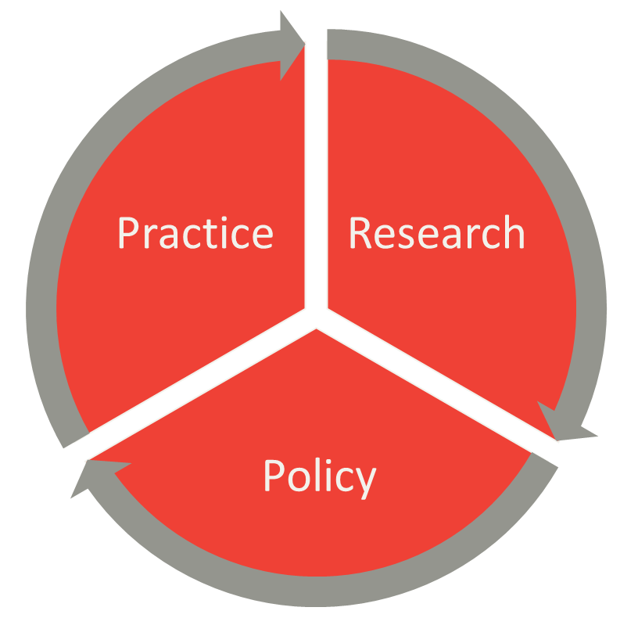
People with dementia and their carers at the nexus
In research, through co-design, study participation and translation of findings
In policy, through submissions and consultations
In practice, through inclusive person-centred care principles and shared decision-making
Notes:
It is critical that people with dementia and their carers are at the nexus of research, policy and practice, so that we can harness the incredible work that it underway.
In research, co-design is so important, so that people with dementia and their carers can influence what is important to them.
In an ideal world, they are involved already at the project/grant proposal stage so that we are not seeking money for projects that are ‘unimportant’
Certainly, they need to be involved in shaping the intervention component of the project.
Of course, they are also involved as research participants, and are critical in shaping and disseminating the findings – helping us to ‘message’ well.
In policy, their involvement is through submissions and consultations – the Royal Commission into Aged Care Quality and Safety and the forthcoming National Dementia Action Plan are some examples.
Dementia Australia, as a peak body advocacy group, uses lived experience voices in their work to inform policy.
And in practice, placing people with dementia and their carers at the heart of inclusive person-centred practice and shared decision-making

Slide 7
Shared decision-making – a shifting paradigm
A shifting paradigm
Convention on the Rights of Persons with Disabilities
Substitute decision making
One person makes a decision on behalf of another
In the person’s ‘best interest’
Shared decision making
Respect for will and preference
Support with decision-making
Intersection of values, preferences, social supports
External facilitation as needed
Ref:
Sinclair, C., Gersbach, K., Hogan, M., Blake, M.,
Bucks, R., Auret, K., . . . Kurrle, S. (2019).
"A real bucket of worms": Views of people living
with dementia and family members on supported
decision-making. Bioethical Inquiry, 16, 587-608.
doi:10.1007/s11673-019-09945-x
Notes:
Decision-making, along the fluctuating journey of dementia, has been shifting paradigm over the last few years.
For a while there, dementia fell between the cracks when it came to protection of human rights.
From 2015 onwards, it has clearly come under the Convention on the Rights of Persons with Disabilities – this is powerful, because we move away from a paternalistic, protective approach, to a rights-based approach around respect for a person’s will and preferences.
Substitute decision-making needs to be questioned – that is, that one person makes a decision on behalf of another, broadly in the person’s ‘best interests’
Shared decision making, likely along a spectrum, is support WITH decision-making. With this approach, there will be an intersection of values, preferences and social supports – an interdependence
There are no doubt challenges in implementing this approach, given that there is a need to navigate the gradual and fluctuating but progressive transitions in dementia, and hence decision making capacity.
It may be that external facilitation is needed, with care staff needing skills in this area.

Slide 8
Research informing practice: Shared decision-making for falls prevention
30-40% of older people fall each year, 5-10% resulting in serious injury
For injuries caused by falls, 60% of hospitalisations and 94% of deaths were for people >65 years
For people with dementia, 60 – 80% fall within a given year, three times the risk of hip fracture and five times more likely to be institutionalised
Notes:
Throughout my clinical physio days, mostly in rehabilitation, we worked with patients to achieve their goals which, I have to say, were mostly to ‘go home’.
It wasn’t until I was successful a number of years ago, in obtaining a PhD scholarship through the Dementia Centre for Research Collaboration and Dementia Australia, that I really delved into shared decision-making.
I took my clinical background and my strong interest in moving evidence into practice into the sphere of falls prevention for people with dementia.
30-40% of older people fall each year, 5-10% resulting in serious injury
According to AIHW, for injuries caused by falls, 60% of hospitalisations and 94% of deaths were for people >65 years – this figure continues to proportionally rise!!
For people with dementia, statistics are even more grim with 60 – 80% fall within a given year (depending on the type of dementia they have), they are at three times the risk of hip fracture and five times more likely to be institutionalized because of the fall/s

Slide 9
Creation of knowledge and context
Systematic review
Development of discussion tool
People with dementia and carers
Health professional involvement
Inclusion of caregiving dyad
Accommodation of individual preferences
Options presented
Benefits of options
Disadvantages of options
Semi-structured interviews
Questionnaire data
Notes:
At the time of commencing this work, there was a fair bit of evidence for what worked in falls prevention for the general older person population (even though falls rates weren’t going down) but there was little specific for people with dementia.
So as all PhD students do, I started with a review of the literature and what aspects were important to translating falls prevention evidence for this population group.
I found that the research questions being studied where not always identical to those questions of importance to the person with dementia and their carers.
To successfully translate evidence into practice, it needed to be relevant, pertinent and meaningful.
The review found that health professional involvement was important, deciphering the evidence available for the general population and how it may benefit people with dementia.
Inclusion of the caregiving dyad was also important, to provide support (physical and emotional) and to interpret health professional information and decision-making – there was an opportunity to work with the dyad, drawing on their very specific knowledge and expertise of HOW falls prevention strategies may work best.
And, coming back to a rights-based approach, accommodation of individual differences and preferences is a tenet of human rights, with the right to be treated with respect and acknowledging and working with their existing capacities
All of this information was collated into a discussion tool (I will show you an example shortly) but in brief it collated the options available for addressing each falls risk factor, and the benefits and disadvantages of taking on this particular strategy.
And finally, the context for individuals was established, through formal assessment tools (such as for functional capacity, dementia severity, activity level, self-efficacy and carer burden), plus an interview to ascertain their perceptions of falls and the meaning they attributed to falls prevention information and education.

Slide 10
Using the curated knowledge to inform choices
Identify high falls risk factors and readiness to change behaviour
Discussion of options
Discussion of reasons to choose/not choose
Ranking of risk factors and choice made
Assistance with implementation of decision
Notes:
So…then moving on to how the curated knowledge was used to inform choices…
High falls risk factors were identified through using a validated assessment tool
Next came the identification of readiness to change behaviour (using Prochaskas stages of behaviour change) – next slide - were they contemplating change (or not even that yet) or were they ready to begin taking action.
Then options were discussed, including the pros and cons of these options – to choose or not to choose
Next came an important component – that the person with dementia (with or without the carer) decided which risk factor was the most important to address first - I believe as health professionals we have to be mindful of not imposing our bias toward a particular form of treatment. As a physiotherapist, I love to give strength and balance exercises, but if the person is not at all interested in exercise, then that particular strategy will potentially fail

Slide 11
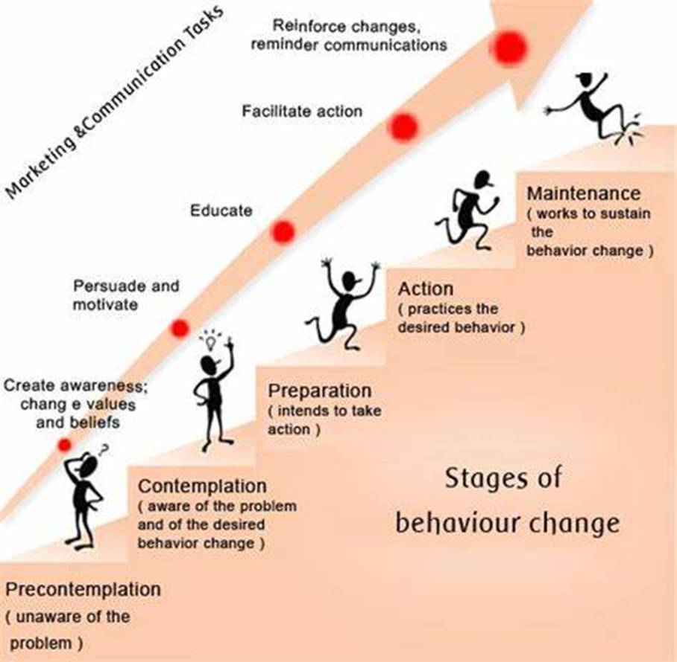
Image courtesy of Pinterest

Slide 12
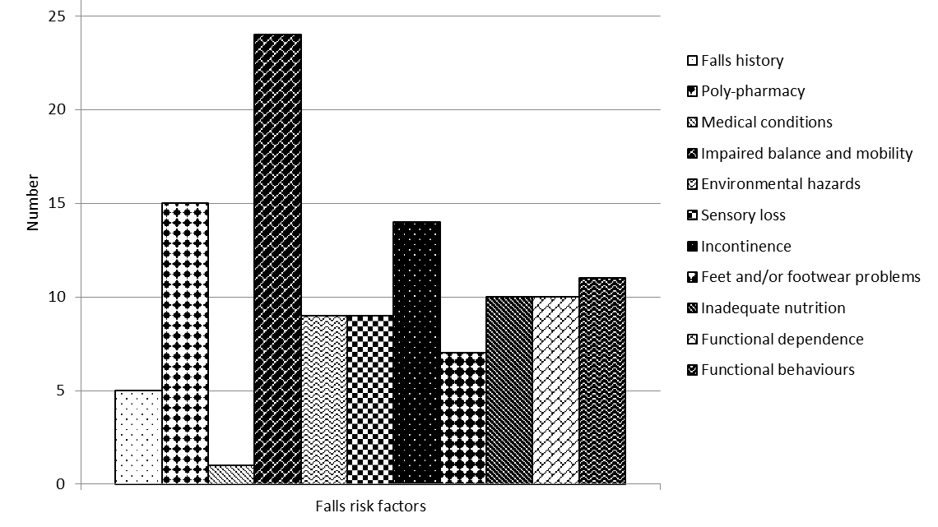
Notes:
I had 25 dyads in my study and this slide gives you a sense of the risk factors that were considered, and shows (even though the patterns are a bit difficult to discern) that impaired balance and mobility was the most common high falls risk factor followed by poly-pharmacy , and incontinence.
In the community, home hazards and the type of shoes that people wear are first and foremost on people’s minds. However, in this case, they were only evident as high risk in about a third of the group.

Slide 13
Options | What would it involve? | Reasons to choose this option | Reasons to avoid this option
Identification and management of strength, balance and mobility concerns | Referral to physiotherapy for exercise program | Strength and balance exercise of sufficient intensity can reduce falls risk | Potential cost and transport Agitation can worsen Need for reminders
Review of meals and meal time as weight loss identified | Familiar / finger foods Consistent routine Plain crockery | Enhance independence, dignity and enjoyment | Wish to maintain long-standing cooking and meal choices
Notes:
Here are a couple of examples of what the discussion tool looked like
Agitation can worsen – this can result from an area of unmet need, such as being in pain or being too hot while exercising

Slide 14
Adoption of falls prevention strategies,
through choices
Potential strategies – referrals, resources, advice/education
Action planning and goal setting
Adoption of strategies high (82.3%)
Notes:
Behaviour change is hard, and the literature tells us that most people don’t take on recommendations – across the board, but also including falls prevention strategies.
But in the case of this study, adoption rates of the recommended strategies were really high >80%
And I humbly suggest it is because I worked so closely with the dyad to decide on whether someone was ready to change behaviour for a given risk factor, or whether they needed some advice and support to BEGIN to contemplate changing it
The difference between somebody who is not ready to change behaviour is that much more time is spent in the discussion phase and perhaps the provision of advice/education/resources. This gives people time to digest the information, talk it through, and more times than not, begin making changes in the right direction
The strategies fell into the categories of referrals, resources and advice/education and at each step of the way…people have choices to make
It’s been a while since this work was completed, but I haven’t yet managed to implement it into widespread practice…it’s time-consuming, messy and resource-intensive, but I haven’t given up

Slide 15
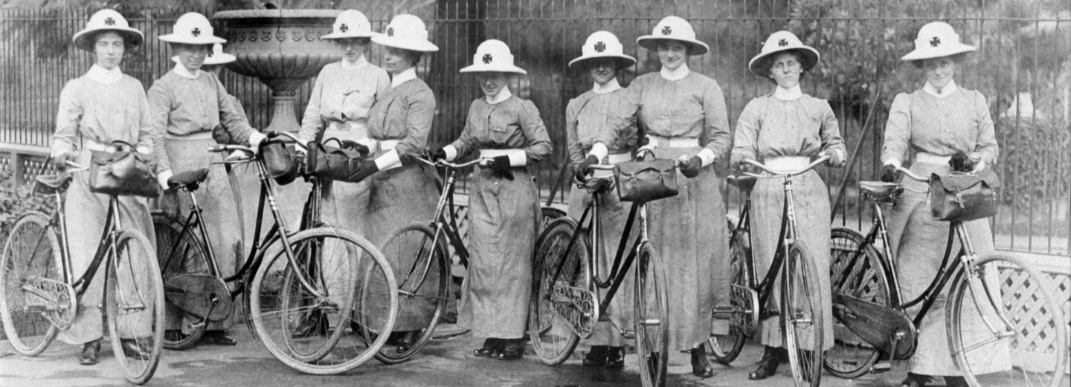
Our history
We have a rich tradition of care starting Australia’s first home nursing service in Melbourne in 1885. From delivering services by bicycle during the Spanish Flu pandemic in 1919, to caring for clients and residents through COVID-19 today, our nurses and carers have been helping people live well for over 135 years.
Notes:
I’ve been working at Bolton Clarke for 8 years, and it is here that I have a hope of implementing evidence into practice.
We have been the merged organisation of Bolton Clarke for 6 years, bringing together the 120 year history of the Royal District Nursing Service in Melbourne (with its founder of Lady Janet Clarke) with RSL Care in Queensland (with it founder of Lieutenant Bolton)

Slide 16


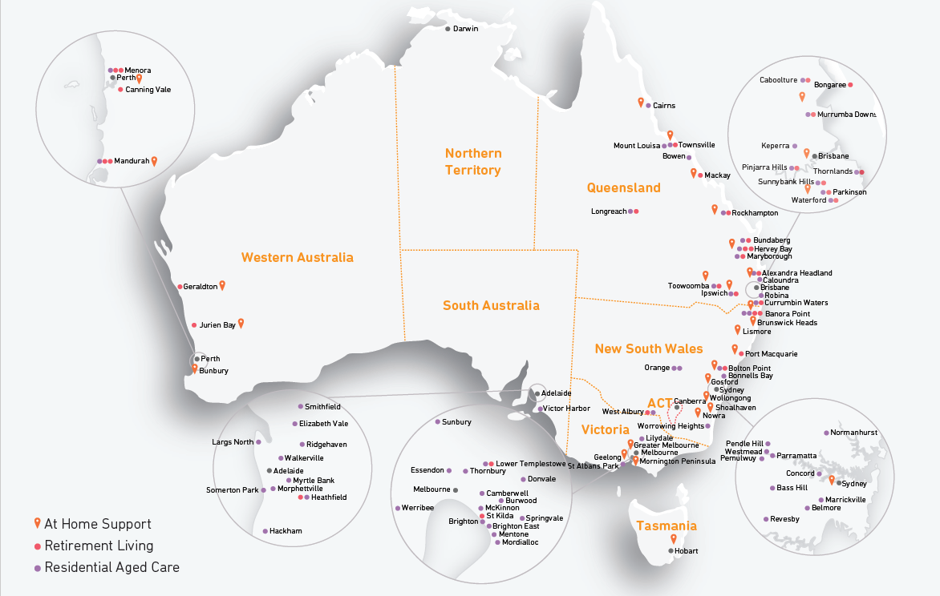
Our operations
Notes:
We are now the largest independent not-for-profit aged care provider in Australia, with operations in all States, but not yet the Territories.

Slide 17







Our services
We offer a full continuum of care to support changing needs.
Home Care
Commonwealth Home Support Program
Home Care Packages
Home and Community Care Program (under 65) (VIC)
Hospital liaison services
Day therapy centres (QLD)
Retirement Living
36 villages across QLD,NSW, VIC and WA
Design, develop, commission and operate villages
Colocation with RAC
Residential Aged Care
70 residential aged care communities across QLD, NSW, VIC and WA
Respite care
Dementia care
Palliative care
Part of the
Bolton Clarke Group
Allity
(currently integrating)
Acacia Living Group
(currently integrating)
Your Choice Homecare
Altura Learning
RDNS New Zealand
RDNS Hong Kong
Chronic disease management
Hospital Admission Risk Program
Transition Care
Restorative and rehabilitation care
HIV / AIDS program
Homeless Persons Program
Telehealth & customer service
Virtual nursing
In home monitoring
Social connection support
National pregnancy, birth & baby health line
Dedicated call centre: 7 days a week, 365 days a year
Language interpreter lines
Education, training & research
Community health and wellbeing education
Nationally accredited courses for workforce development
Bolton Clarke Research Institute
Notes:
We offer a full continuum of care to support changing needs, across Home Care, Retirement Living and Residential Aged Care
The Bolton Clarke Research Institute supports the organisation to move evidence into practice

Slide 18
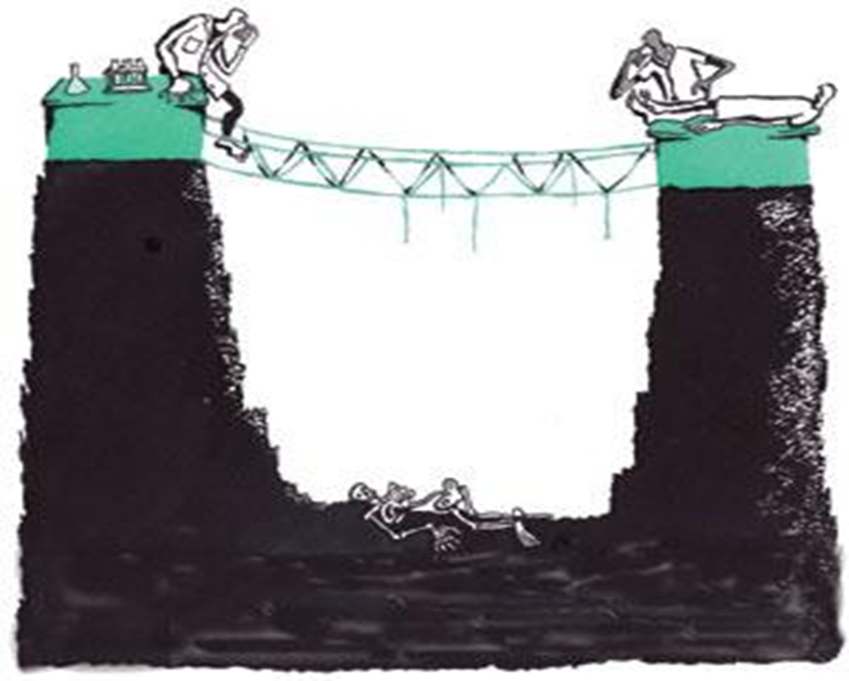
Challenges for implementation
Ref: Mellor B. Nature. 2008; 453
Notes:
Which we know is an enormous challenge!
Unfortunately, this is what happens to most research…and if it is implemented into practice, it can take up to 17 years.

Slide 19
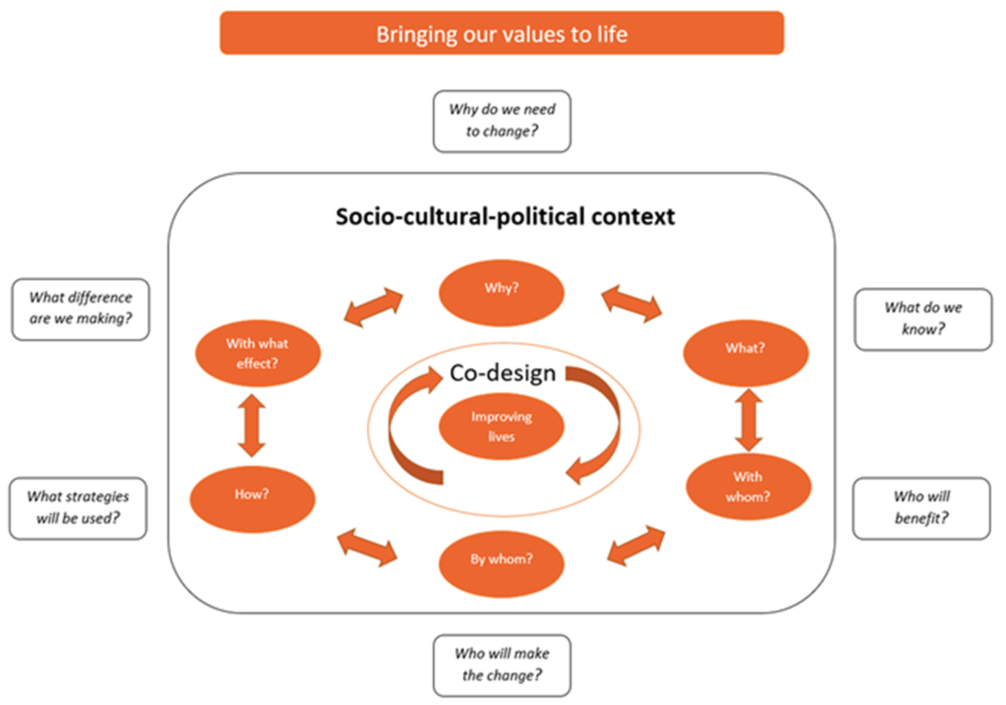
Mellor B. Nature. 2008; 453
Meyer, C., Ogrin, R., Golenko, X., Cyarto, E., Paine, K., Walsh, W., Hutchinson, A., Lowthian, J. (2022). A co-designed fit-for-purpose implementation framework for aged care. Journal of Evaluation in Clinical Practice. 28 (3), 421-435. DOI: 10.1111/jep.13660
Notes:
The Bolton Clarke Research Institute set out to develop an implementation framework that is fit for purpose.
It was adapted from numerous other models and frameworks, particularly John Lavis’ work from Canada – there’s amazing work out there, but it was a matter of balancing the theory with the practicality of our position within the organisation.
This is what it looks like – bringing our organisational values to life and viewed within the current socio-cultural-political context - the real world of health care
At it’s heart is improving lives - of older people, our workforce, and other stakeholders
All the work is underpinned by co-design principles before we start with the important question of WHY are we needing to change and then progressing iteratively through the questions.

Slide 20
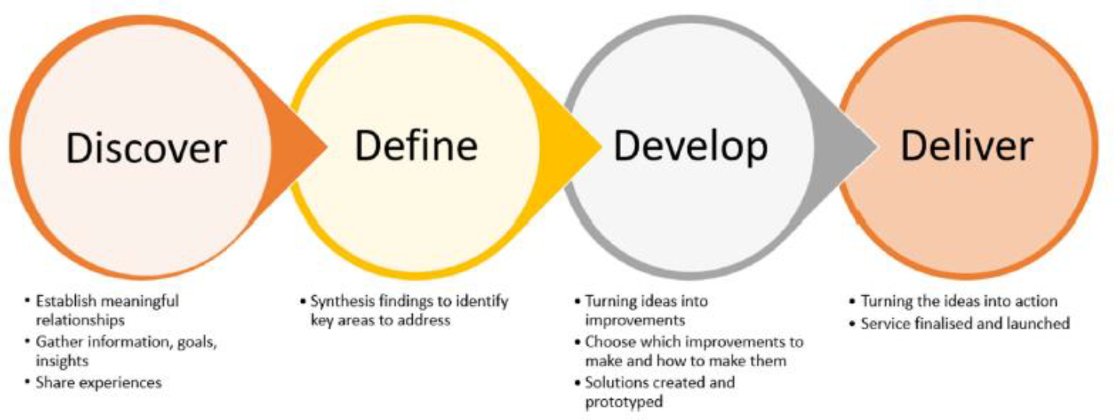
Co-design framework
Ref: Meyer, C., Ogrin, R., Golenko, X., Cyarto, E., Paine, K., Walsh, W., Hutchinson, A., Lowthian, J. (2022). A co-designed fit-for-purpose implementation framework for aged care. Journal of Evaluation in Clinical Practice. 28 (3), 421-435. DOI: 10.1111/jep.13660
Notes:
The co-design framework we use is based on the Double Diamond design model, iteratively gathering information and insights and building relationships, then synthesising these findings into a ‘prototype’ and begin to test it.
No surprises here, but often going back again when a prototype needs further refining

Slide 21
Enabling Choices conversation tool
Duty of care
The right to take risks
Notes:
I’d like to take you through another project – Enabling Choices - which uses this implementation framework in order to achieve the best outcomes for people with dementia and their carers in our home care service
Negotiating risk within community aged care is complex and often fraught…especially for people with dementia
Our nurses conduct over 4 million visits per year to older people in the community
On a daily basis they are faced with the need to negotiate risk…to balance their duty of care to the older person, to potentially navigate competing interests of family members, and the right of the client to take risks
The older people they see in the community are not just people who need a little bit of help…these are people who have multiple health problems and often very complex social situations
Negotiating risk is part of what they do

Slide 22
Enabling Choices conversation tool
2016-2018
2019-2021
2021-2023
Paper-based version co-designed with people with dementia, informal carers and community aged care staff
59 original areas of risk consolidated into 12 areas of activities of daily living
Conversion of the tool into a prototype electronic format through co-design with Information Technology, Clinical Nurse Consultants, Operational Management and Social Work
Nine staff members provided individual feedback on ease of navigation/functionality and content
Testing with PwD and carers postponed due to Covid-19, but now underway with NSW HCP team
Ready for implementation into practice, but implementation strategies unclear
Notes:
I’m not yet at the 17 year mark, but it feels as though this has been a long journey to bring the conversation tool into practice.
Back in 2016, some colleagues of mine developed the Paper-based version co-designed with people with dementia, informal carers and community aged care staff
59 original areas of risk consolidated into 12 areas of activities of daily living

Slide 23
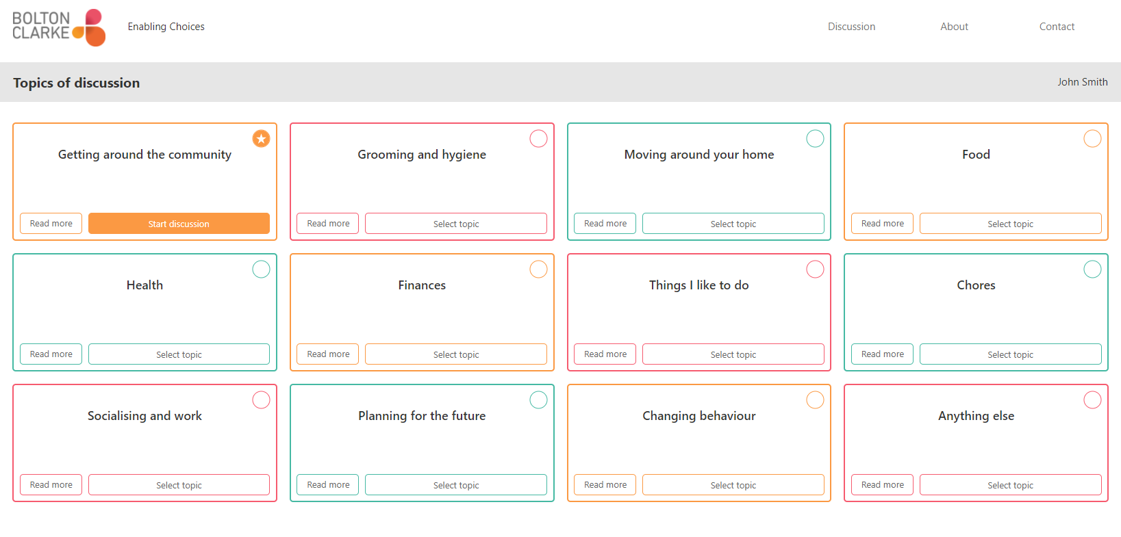
Notes:
There are 10 cards in total and the idea is that people have a look at the cards and choose a card that resonates with them, something that they might like to discuss further (or the carer)

Slide 24
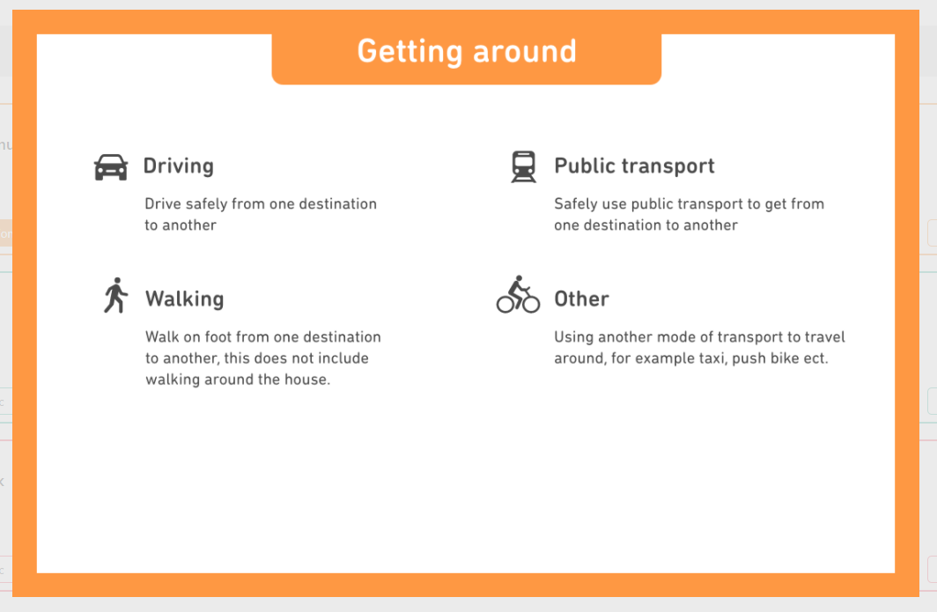
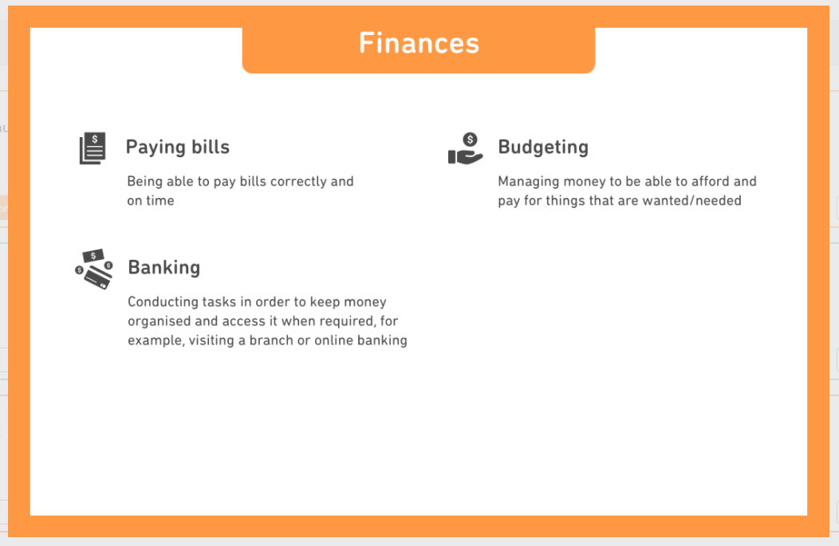
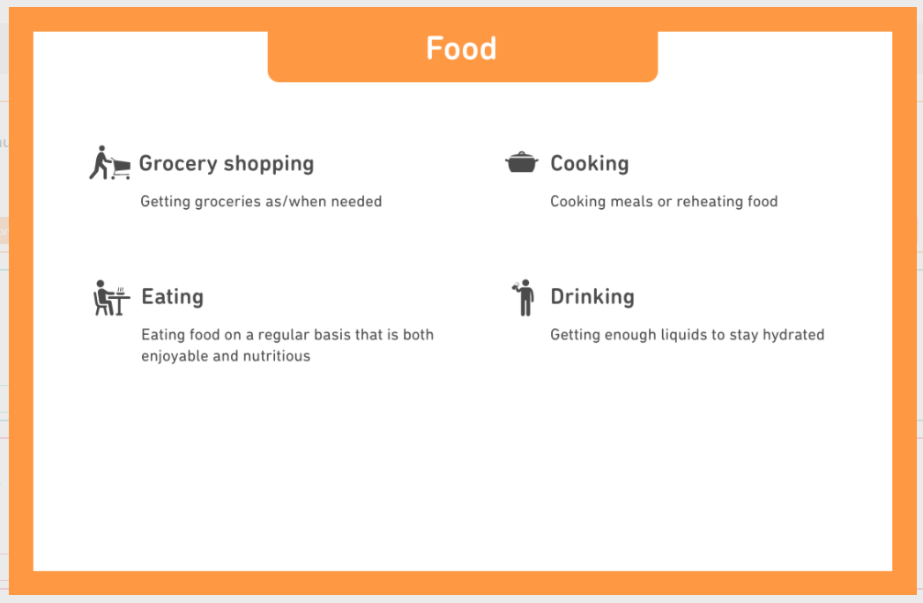
Notes:
Here is a sample of the cards
There are 10 cards in total and the idea is that people have a look at the cards and choose a card that resonates with them, something that they might like to discuss further (or the carer)
So…for example…here we have ‘getting around’
It has icons for driving, public transport, walking and other (e.g. bike), with some simple words that can be read or read out.
Then we have ‘finances’ and ‘food’

Slide 25
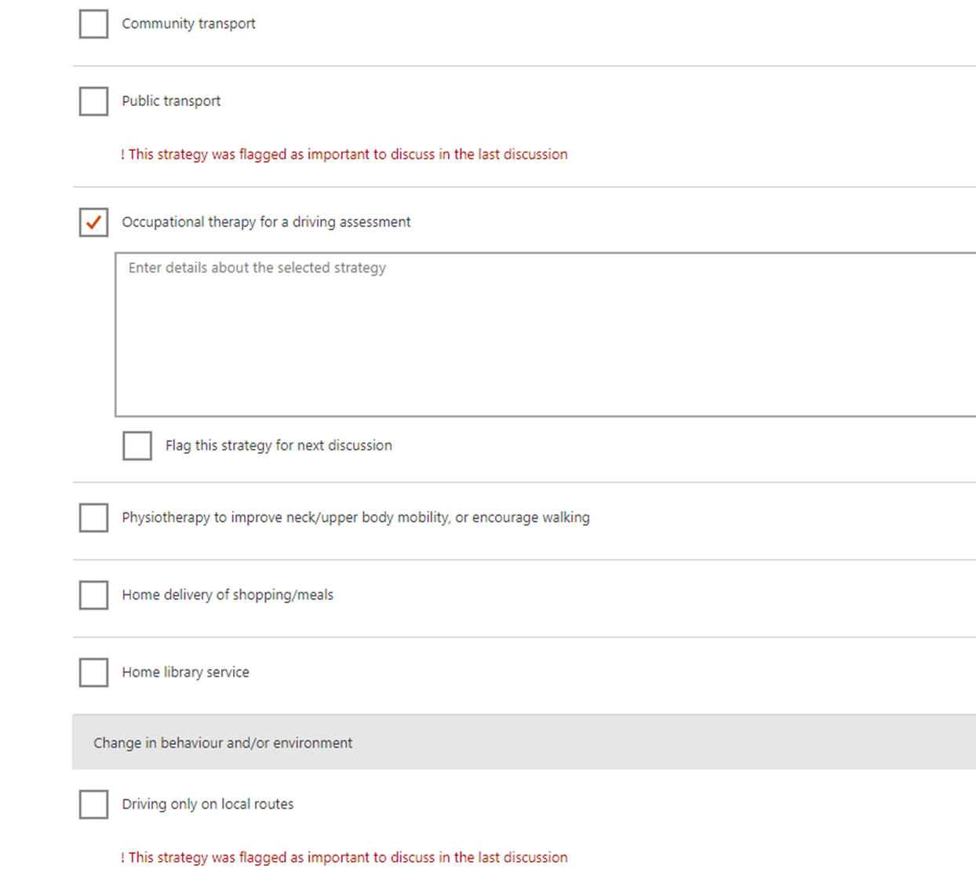

Slide 26

Changing the Focus: Facilitating engagement
in physical activity for people with dementia
in a local community
Co-design of program
Development of professional training & resources
Testing through shared decision-making

Slide 27
Development of personas
Reluctance to engage
Preparing to engage
Actively engaged
Pre-contemplation stage of change
Carer frustration
Little motivation
Denial, embarrassment
Linking physical activity to ‘being hassled’
Contemplation, preparatory stage of change
Finding motivation
Previous experience
Reduced confidence and/or changing needs
Assisting physical activity set-up
Active, maintenance stage of change
Positive health-seeking behaviour
Responding promptly to changes in ability or motivation
? Need for program adaptation or change of activity

Slide 28
Opportunities for referral pathways
Champions
Streamline processes
Recognition of triggers
Beliefs and attitudes
Communication
Peer coaching
Formal/informal carers
Social prescribing
Minimise referral ‘rules’
Integrate services
Feedback to referrers
Medical conditions
Physical decline/frailty
Social isolation
Case studies/stories
Outcome measures
Linking physical with cognitive
Promotional material
Dementia-friendly services
Positive ageing

Slide 29
Capability
Opportunity
Motivation
Getting it right first time
Physical and cognitive needs
Suitable environment
Adapting, or prepared to change
Accessibility – physical, financial
Try before you buy – it’s OK to change
Acceptability of program
Goal setting, regular f/u
Advantages, disadvantages
Suitable program/leader, time & place
Combine with social needs
Confidence, fun
Helping to change behaviour

Slide 30
Where to from here?
Research
Policy
Practice
Collaborating Research Centres
Individual and joint submissions
Collaborative partnerships with other peak bodies
Australian Ageing Agenda
AAG Research Trust
Australasian Journal on Ageing
Student and Early Career Group
National Aged Care Alliance
ATSIAAG
IAGG and ILC
ANZSGM
Connecting people
Online community
Webinars
Special Interest Groups
State and Territory Divisions
Conference/s

