Slide 1
Reorganising care environments to provide safe & effective person-centred dementia care
Dr Frederick Graham (PhD, BNurs)
CNC Dementia and Delirium Nursing Service (PAH)
Senior Research Fellow (CHSR-UQ)
Notes:
Thanks and acknowledge team
Prof Hubbard my early career research fellow mentor
Clinical and research colleagues Dr Gordon and Dr Kelly

Slide 2

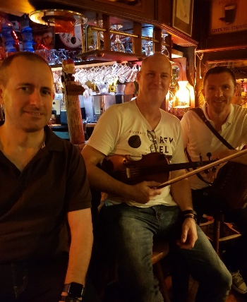
Fun fact about me
CNC PAH; Senior Lecturer CHSR, UQ.
Research: Hospital care for people with dementia
Love to play my fiddle, cook pizza in my woodfired oven (it’s a way of life), wilderness, camping, gardening, and keeping up with what my adult kids are up to (boy and girl)

Slide 3
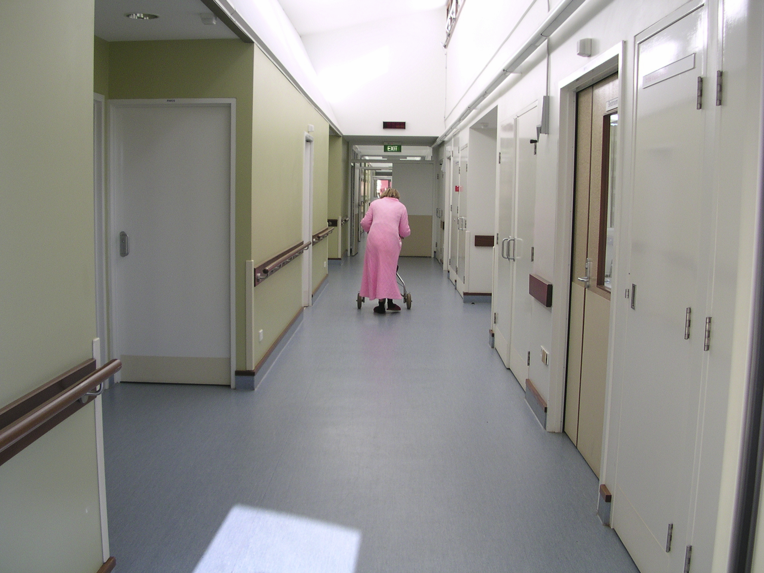
95yr old woman tasered by police in nursing home
.
93yr old man from nursing home sent hospital for waving a coat hanger. Dies from aspiration pneumonia due to sedation.
.
74yr old man with PD and PTSD from childhood sexual abuse dies in hospital with sepsis due to infected wounds from 4-point physical restraint
Distressed 97year old female with delirium on dementia and injuries receives 4-point leather restraint, sedation and no pain relief in ED
.

Slide 4
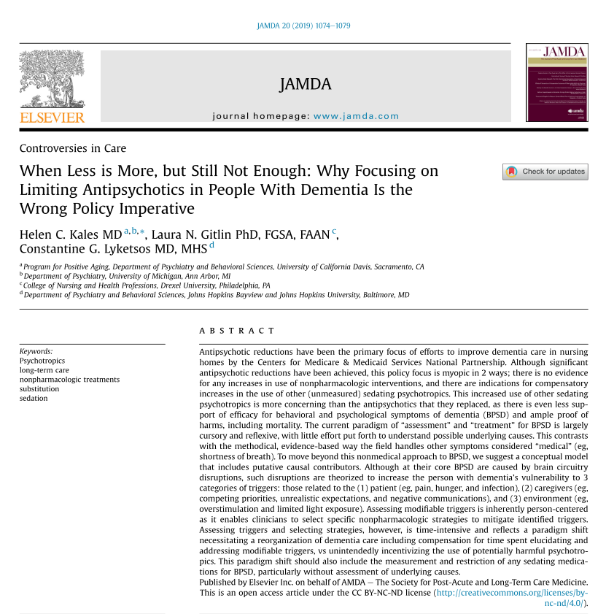
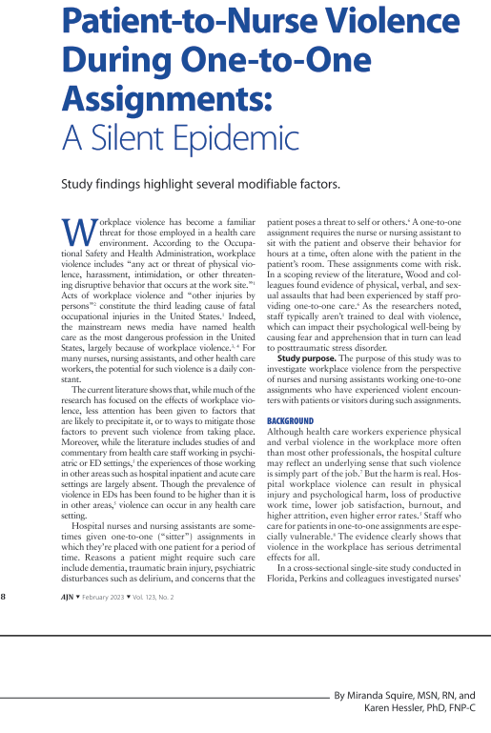
Delirium has the highest odds ratio for occupational violence on medical, surgical and rehabilitation wards (OR 11)
Williamson et al., (2014)
.
Dementia is next with OR of 7
Williamson et al., (2014)

Slide 5
Model of care
Kales, H. C., et al. (2015). "Assessment and management of behavioural and psychological symptoms of dementia." BMJ: British Medical Journal 350(8003): h369-365.

Slide 6
The work of reorganisation of dementia care
Assessing modifiable triggers and selecting specific non-pharmacological strategies is time-intensive, necessitating reorganization of dementia care including compensation for time set elucidating and addressing modifiable triggers…
(Kales, Gitlin,& Lykestos., 2019)
Training and capacity building workplaces and staff to do the above requires intensive work and compensation as well

Slide 7




50% of aged care residents have dementia
AIHW., (2023)
2 in 5 older hospital inpatients have dementia and/or delirium
Travers et al., (2013), Mudge et al., (2021)
Up to 75% of inpatients with dementia experience agitation
Sampson et al., (2019), Boltz et al., (2023)
Agitation is a cluster of behaviours including restlessness, pacing, repetitive vocalisations and verbally and physically aggressive behaviours
Sampson et al., (2019)

Slide 8
Common reasons for changed behaviours
Communication difficulties – frustration, misinterpretation (allowed time)
Unfamiliar surroundings and people
Boredom or lack of meaningful familiar routines
Over stimulation
Resistance to cares (reactive aggression) – not understanding the reasons for care (memory, lack of insight) and/or wanting to remove unwanted attention
Wanting to leave when unsafe to do so – unfamiliar or unsafe or unpleasant place or “need to do things”
Reaction to constraints, restrictions
Anxiety from content of delusions or hallucinations
Wayfinding difficulties
Discomfort and/or pain
Delirium (odds ratio 6 for people with dementia)

Slide 9
Mudge AM, Lee-Steere K, Treleaven E, Cahill M, Finnigan S, McRae P; Australian Health Review (2021).

Slide 10
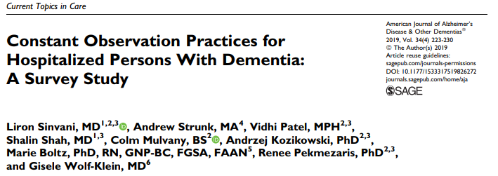
Extra resource costs in staffing
Survey of registered nurses on wards in 5 hospitals in New York
84.2% reported caring for a patient requiring a special at least once a week
60.7% for agitation in dementia

Slide 11






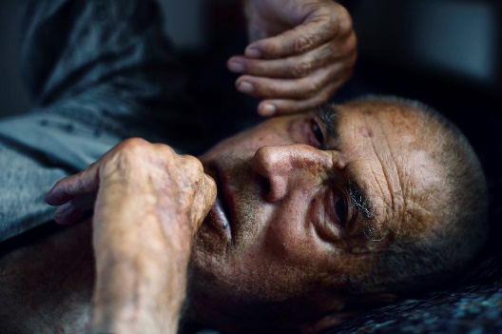




Poor outcomes for patients and staff
Adverse events, infection
Double length of stay
Disrupted treatments
Potentially harmful psychotropic sedation & restraint
Higher mortality
Complications more costly than other complexity ¹ + extra staffing costs
Twice as likely to fall
Highest risk for patient-to-nurse violence
More likely to be discharged to a facility
^{1.} Bail et al., (2018)
Notes:
The poor hospital outcomes associated with dementia are well documented
Increased risk of falls, adverse events, disrupted treatments, restrictive practices, and longer length of stay.
BPSD like agitation have a significant role to play, in particular, causing

Slide 12
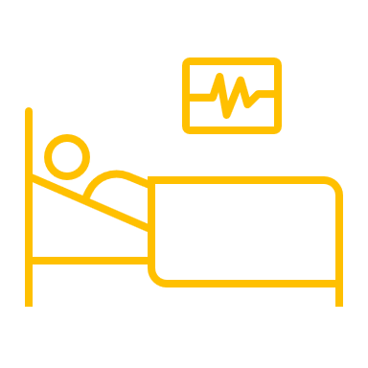


Poor outcomes for patients and staff
Adverse events, infection
Double length of stay ¹
Disrupted treatments
Potentially harmful psychotropic sedation & restraint
Higher mortality ¹
Complications more costly than other complexity + extra staffing costs ²
Twice as likely to fall
Highest risk for patient-to-nurse violence
More likely to be discharged to a facility ¹
^{1.} Tannenbaum et al, (2022)
^{2.} Sinvanni et al., (2018)
Notes:
And the presence of BPSD like agitation have a significant role to play, in particular, causing increased morality, discharge to facilities, extra costs in specialling.

Slide 13
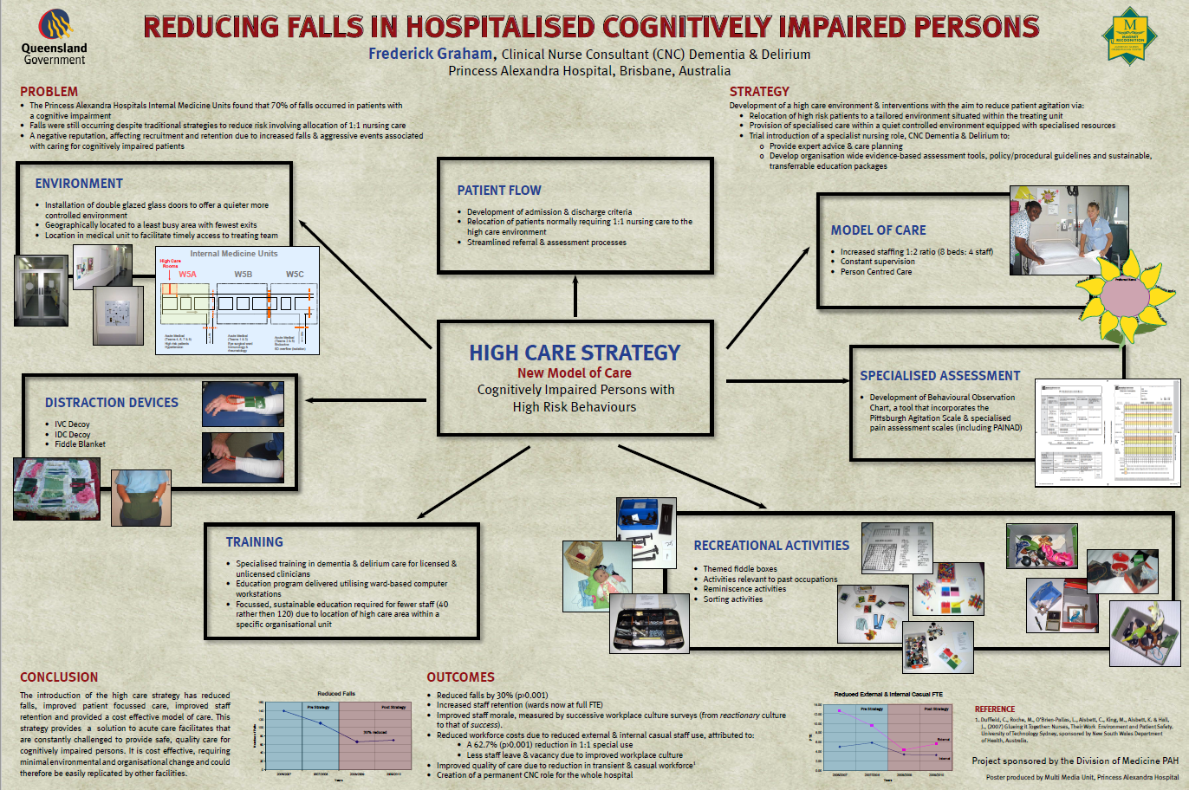

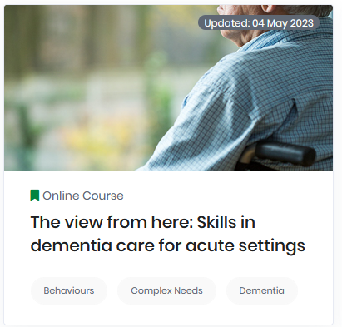
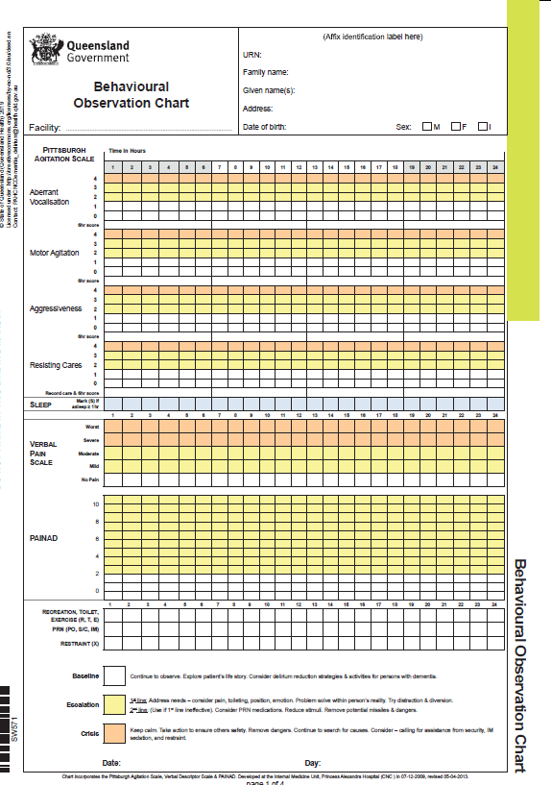

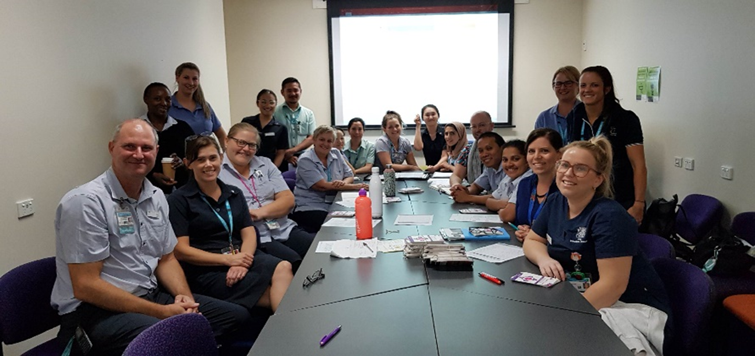
CNC Dementia Role
Evidence based co-location strategy
Poster - Graham (2011), NY study - Sinvanni et al (2018)
Mandatory online learning
Pain-related behavioural observation tool
Change Champions network
PAH study CogChamps - Travers et al., (2018)
Significant rates of occupational violence, specials & staff burnout
Person-centred communication
Notes:
At our hospital site we had undertaken extensive work over the last decade or so, to capacity build our medical wards to provide better inpatient dementia care.
BUT… even with this work by late 2015 we began to experience higher rates of occupational violence, more mobile patients with significant BPSD, leading to more specials and staff burnout.

Slide 14
Routines of resistance
More people living with dementia
RACFs unable to manage BPSD (assumption that hospital is safer)
Older medical inpatients that are reacting to the setting
Increasing care burden at home
System priorities mismatch to patient needs
Specialist versus generalist
Physical design
Forced care due to system priorities ^{(Featherstone et al, 2019)}
Missed/rationed cares ^{(Bail & Grealish, 2016)}
Competing needs/priorities ^{(Yous et al, 2019)}
Staff “conflicted” over the care delivered ^{(Gwernan-Jones et al 2019)}
“Socialised care futility” ^{(Beaver et al, 2020)}
No validated models of care ^{(Dewing and Dijk, 2016)}
Notes:
There are possibly several reasons for this.
The prevalence of dementia in the community is rising.
Residential aged care is not able to manage significant BPSD with an assumption that hospitals are safer
More older medical patients with undiagnosed dementia reacting to factors in the acute setting
Increasing burden of care at home
The system is not geared for this
Physical design
Specialist versus generalist skills – it is skilled work
Hospital system priorities lead to a care mismatch

Slide 15
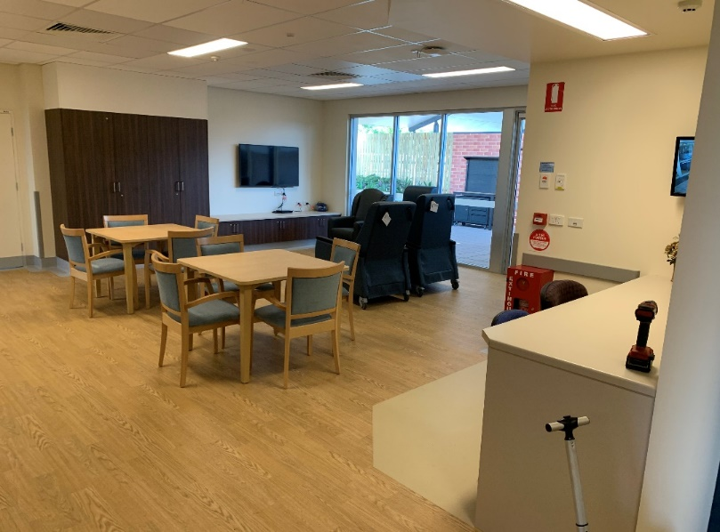

More people living with dementia
RACF’s unable to manage BPSD (assumption that hospital is safer)
Increased older medical inpatients that react to setting
Increasing care burden at home
System priorities mismatch to patient needs
Specialist versus generalist
Physical design
Need a Buffer!
Notes:
Need a buffer from these pressures

Slide 16

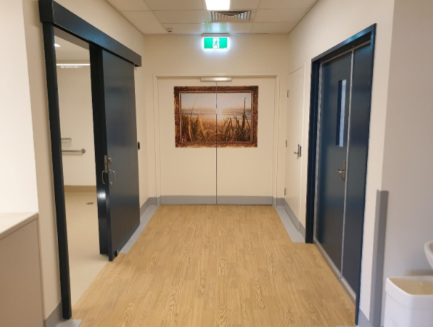
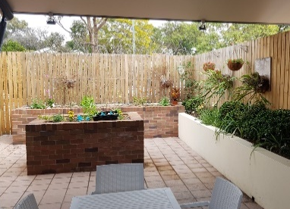
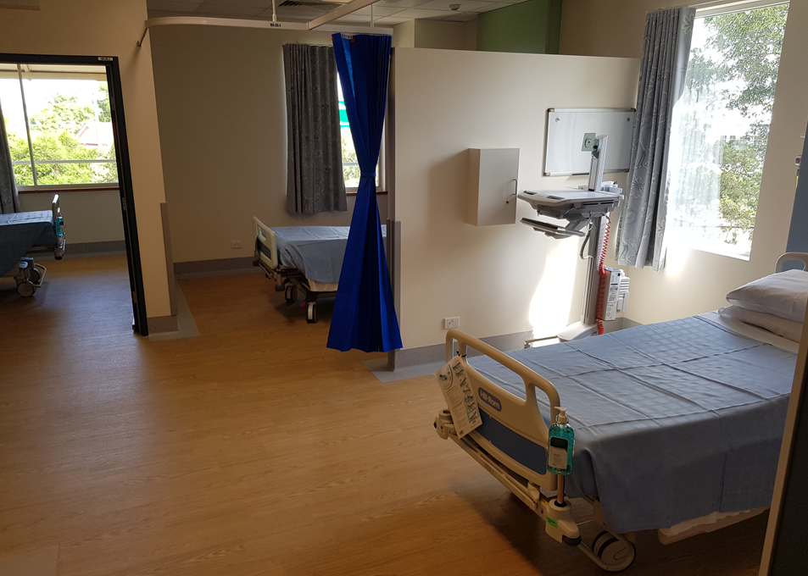
Acute Cognitive Unit
Specialised team
Geriatrician + advanced trainee
Specialist dementia nurses (CNC, CN)
Nurse navigator (dementia)
Increased nursing ratio (2:1)
Neuropsychologist (0.5FTE)
Social work (0.5FTE)
Leisure therapist (0.5FTE)
Allied health team (PT, OT, Speech, Dietician)
Dementia enabling design (8-beds)
Admission criteria
Independently mobile patients experiencing difficult to manage BPSD on ward
Geriatrician admission
Dementia & Delirium Nursing Service workup
Notes:
Successful in advocating 8-bed unit with a model of care and specially designed environment

Slide 17
Acute Cognitive Unit
Specialised team
Geriatrician led medical team
Clinical nurse consultant (dementia)
Nurse navigator (dementia)
Increased nursing ratio (2:1)
Neuropsychologist
Social work
Leisure therapist
Allied health team (PT, OT, Speech, Dietician)
Dementia enabling design (8-beds)
Admission criteria
Independently mobile patients experiencing difficult to manage BPSD on ward
Geriatrician admission
Dementia & Delirium Nursing Service workup
Aims
Reduce BPSD severity and patient distress
Develop effective and sustainable care plans
Reduce impact of BPSD on hospital wards

Slide 18
D
Describe
Caregiver describes problematic behaviour
Context (who, what, when, and where)
Social and physical environment
Patient perspective
Degree of distress
I
Provider investigates possible causes
Patient
  Medication side-effects
  Pain
  Functional limitations
  Medical conditions
  Psychiatric co-morbidity
  Severity of cognitive impairment
  Poor sleep hygiene
  Sensory changes
  Fear, sense loss of control, boredom
Caregiver/expectations
Social and physical environment
Cultural factors
Investigate
C
E
Provider, caregiver and team collaborate to create and implement treatment plan
Respond to physical problems
Strategize behavioural interventions:
  Providing caregiver education and support
  Enhancing communication
  Creating meaningful activities
  Simplifying tasks
  Ensuring environment is safe
  Increasing or decreasing stimulation
Create
Evaluate
Provider evaluates whether “CREATE” interventions have been implemented by caregiver and are safe and effective
Kales, H. C., Gitlin, L. N., & Lyketsos, C. G. (2014). Management of neuropsychiatric symptoms of dementia in clinical settings: recommendations from a multidisciplinary expert panel. Journal of the American Geriatrics Society, 62(4), 762-769. doi:10.1111/jgs.12730,
Notes:
Fred:
- Its not just the environment
Process of developing care
Organised meeting with family and care givers
Establish goals of care together

Slide 19
Stress–Competence Models (i.e., person-environment fit)
Lawton’s Ecological Theory of Ageing
Notes:
Fred

Slide 20
Responsive behaviours may have a temporal pattern. As stress accumulates during the day, a persons threshold is eventually exceeded, and by afternoon or evening they may cycle between anxious and impaired function (responsive behaviours).
Impaired Function
Stress Threshold
Anxious Behaviour
Normative behaviour
AM
Noon
PM
Night

Slide 21
Through targeted and timely interventions, stressors can be reduced, thereby avoiding anxious behaviour, more impaired functioning and responsive behaviours.
Impaired Function
Stress Threshold
Anxious Behaviour
Normative behaviour
AM
Noon
PM
Night

Slide 22
Needs-driven dementia-compromised Behaviours (NDBs)
Background Factors
Neurological status: Stage and cause of dementia, motor, language and sensory ability
Health Status: age, co-morbidities, gender
Premorbid characteristics: personality, past life experiences, past/present career, response to stress
Proximal Factors
Physiological factors: hunger, thirst, pain, discomfort, need for elimination
Psychosocial factors: mood, emotion, boredom
Physical environment: physical design, light, temperature, noise, crowding, routine
Social environment: staffing and staff environment, social network
Need-Driven Behaviour (NDB)
Agitation
Aggression
Apathy
Wandering
Vocalisations
Algase, D. L., Beck, C., Kolanowski, A., Whall, A., Berent, S., Richards, K., & Beattie, E. (1996). Need-driven dementia-compromised behavior: An alternative view of disruptive behavior. American Journal of Alzheimer's Disease, 11(6), 10-19.

Slide 23








Cognition Support Plan
Geriatrician
Unit nurses
Social worker
Leisure therapist
Dementia nurse specialists
Neuropsychologist
Cognition Support Plan
Physio, OT, speech
Community transition/support
Dementia nurse navigator
Notes:
Whole team works within the unit to produce a 1-page cognition support plan that can go with the patients back into the community once proven effective.
Truly interprofessional practice.

Slide 24
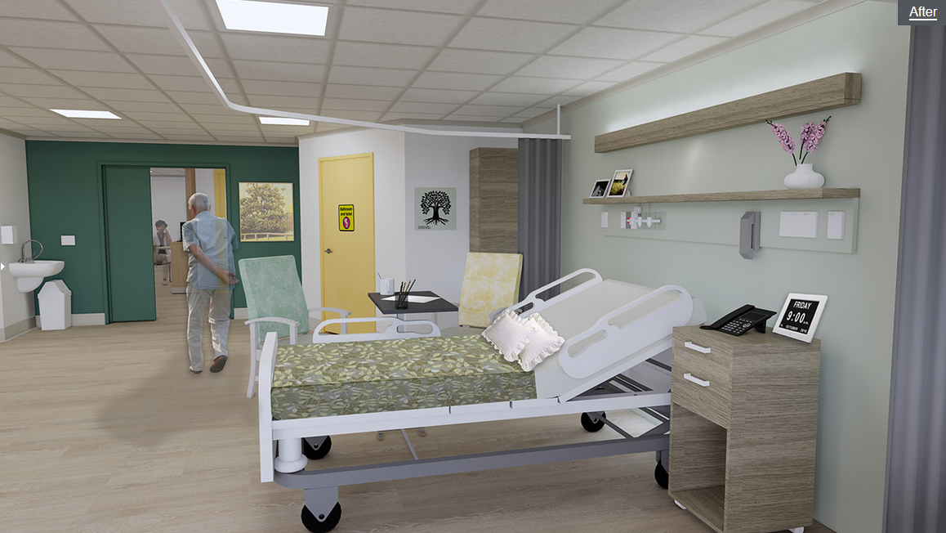
10 Principles of dementia enabling design
Notes:
Physical design work using Prof. Richard Fleming's 10 principles for dementia enabling design.

Slide 25
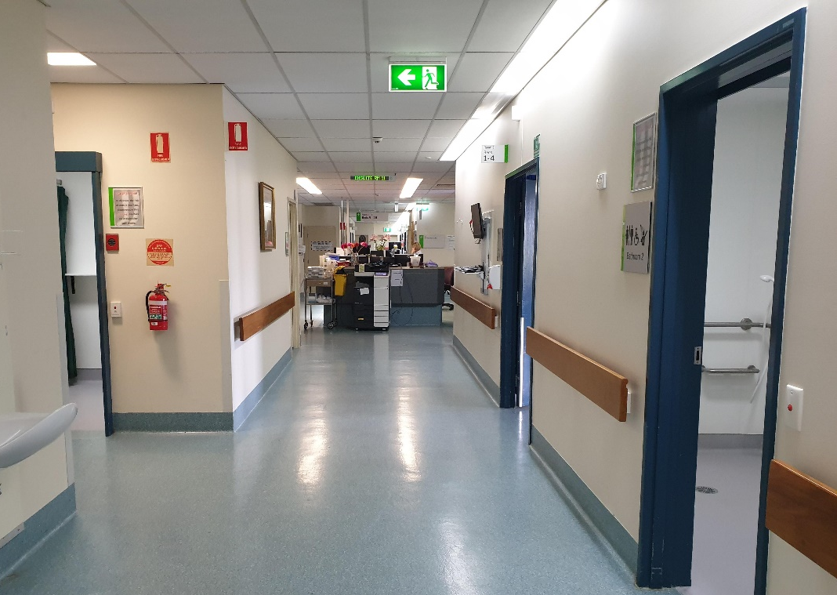
Unobtrusive safety, reduce unhelpful stimulation, optimise helpful stimulation, create familiar space

Slide 26
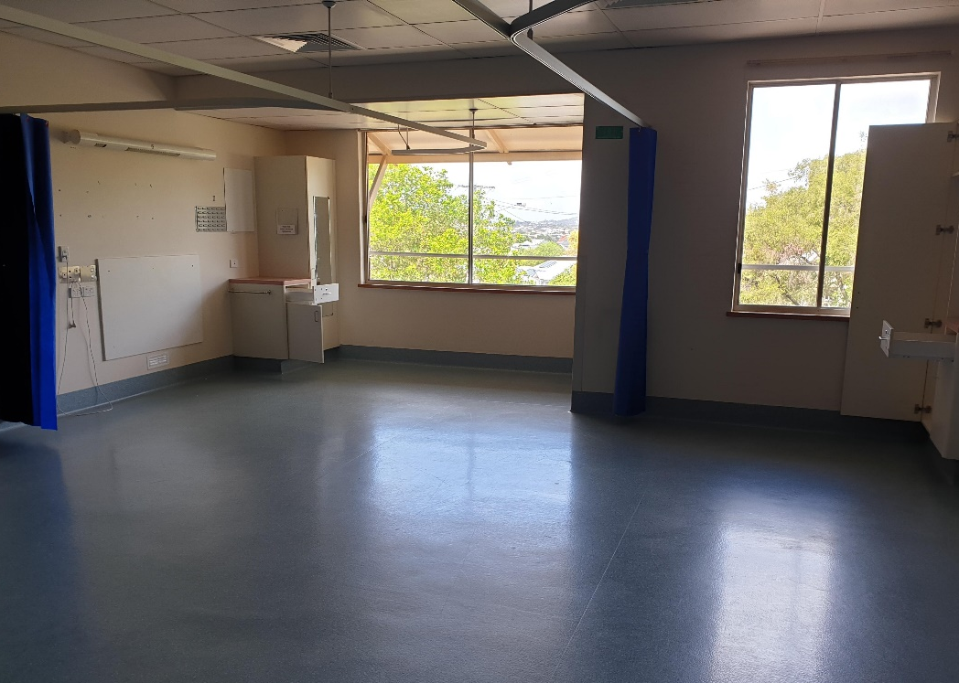
Familiar space, human scale, opportunities to be alone or with others

Slide 27
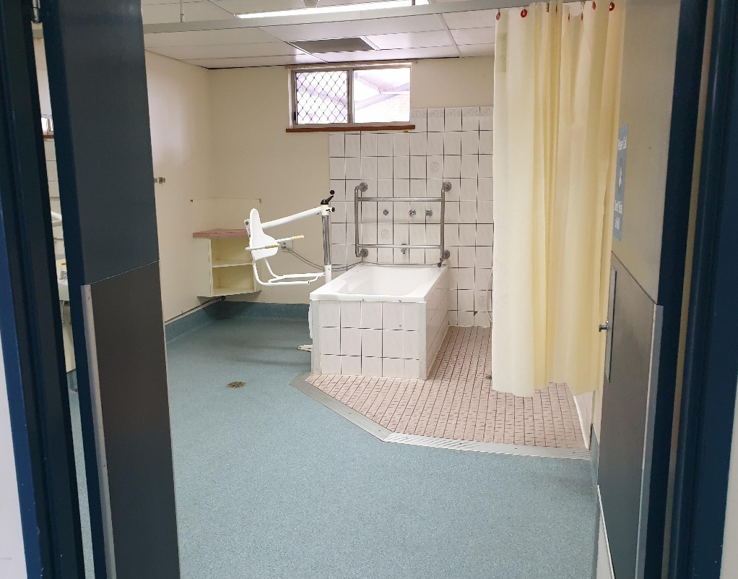
Allow people to see and be seen, create familiar space, opportunities to be alone with others, vision or way of life

Slide 28
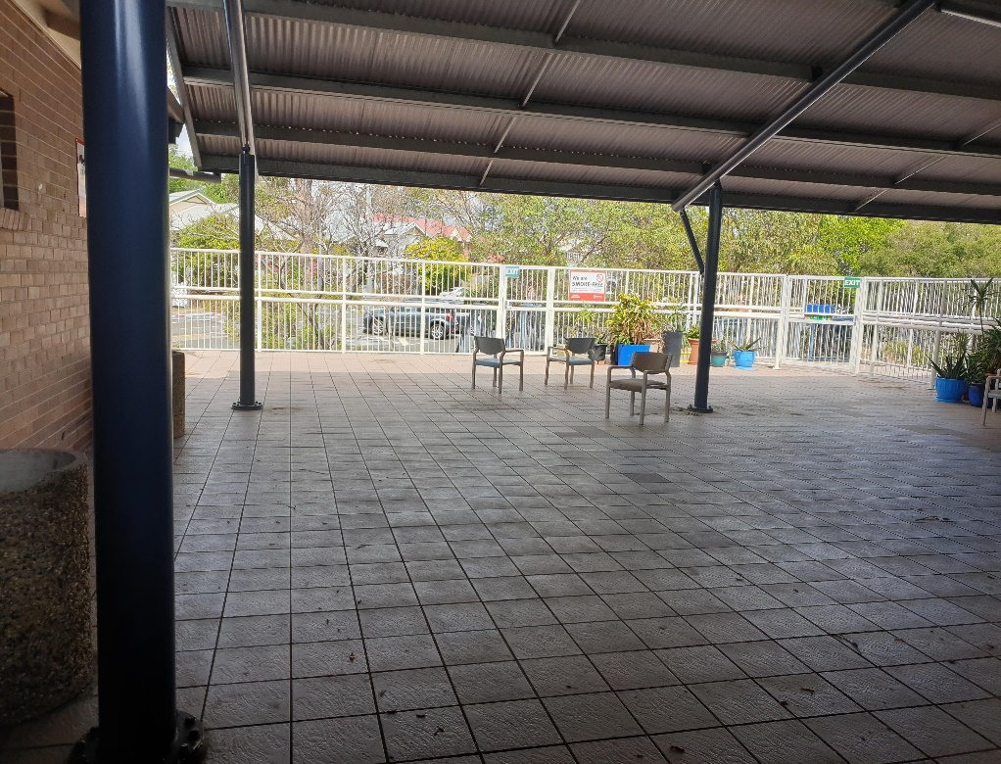

Provide human scale, allow people to see and be seen, create familiar space, opportunities to be alone with others, vision or way of life

Slide 29
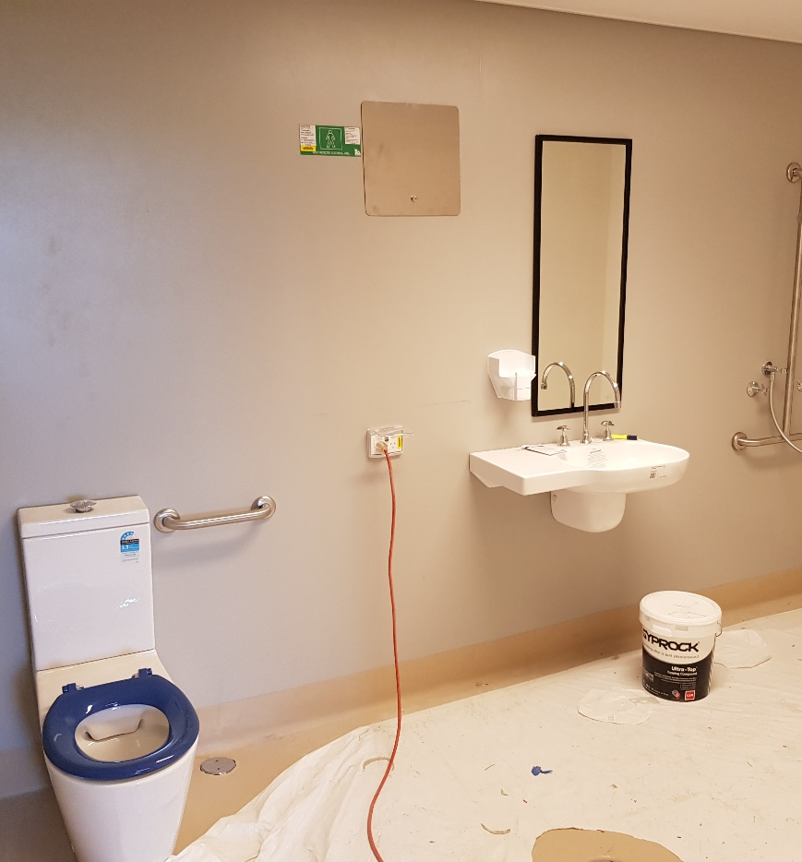
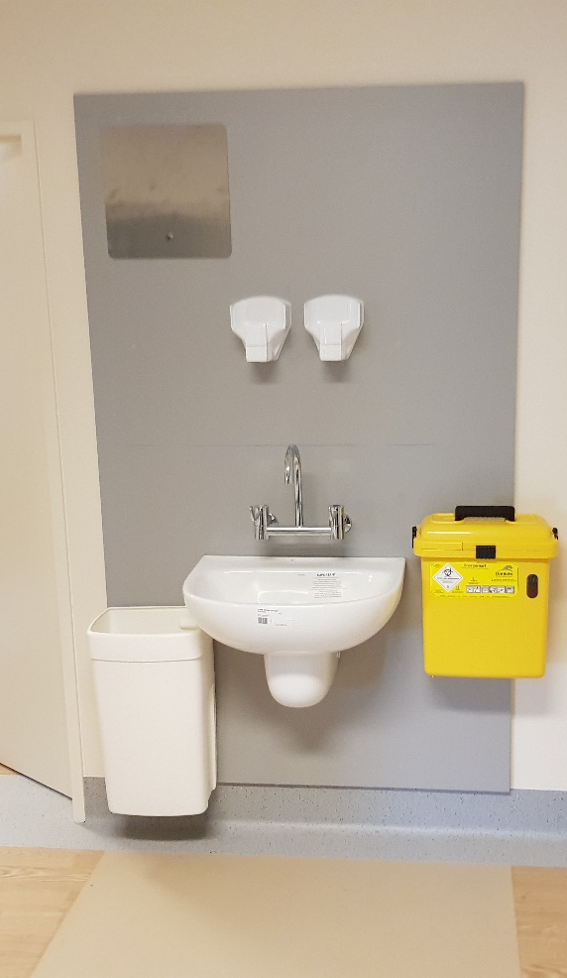
Helpful stimulation – contrasting toilet seat, contrast wall colour against basins

Slide 30
Single-case multiple baseline design
General ward care
ACU care
Behaviour severity scores (4 days ± 1 day)
NPI-C: Neuropsychiatric Inventory Clinician (score 0-42)
RAGE: Aggression Rating Scale (score 0-61)
CMAI-Acute: Cohen-Mansfield Agitation Inventory (score 9-45)
Retrospective chart (each 4-day period)
Medications:
Antipsychotics
Benzodiazepines
Analgesia
Drug Burden Index
Events
Falls & pressure injury
Security callout
Restraint
Special usage
Occupational violence
General ward care
ACU care
Pre-post analysis of 3 feeder wards + ACU
General ward care
ACU care
2yrs pre & 2yrs post (monthly incident reports)
Falls
Occupational violence
Pressure injury
Notes:
Research methods
Single case multiple baseline design – where repeated measures are made on individual cases when receiving different care and then analysed within and between cases, so that the case becomes its on control
Also a pre-post analysis of incidents reports across the 3 feeder medical wards and the ACU ward

Slide 31
January 2020 – January 2022
(Independently mobile patients with dementia and clinically significant BPSD)
137 admissions
12 admissions
No dementia
No BPSD, bed flow pressures
Palliative on admission
125 admissions
1631 observations (4-days ±1 day)
Dementia & Delirium Nursing Service
Interrater reliability - two-sample paired t-tests demonstrated variance between 1-external and 2-internal assessors < 6%.
On the Rage and CMAI variance for chart-reviewed assessments was <1%.

Slide 32
(2020-2022)
Demographics (2-years) |  |  | N = 107
Age, years, Mean (SD) |  |  | 78.6 (7.9)
Age group, years, n (%) | <70 70-74 75-79 80-84 85+ |  | 14 (13.1) 17 (15.8) 28 (26.7) 22 (20.6) 26 (24.3)
Sex, n (%) | Female Male |  | 41 (38.3) 66 (61.7)
Diagnosis, n (%) | AD VaD Mixed Alcohol-related Dementia (no type) Dementia in MH LBD PD Other (e.g., SDH) |  | 33 (30.8) 18 (16.8) 24 (22.4) 7 (6.5) 8 (7.5) 7 (6.5) 4 (3.7) 3 (2.8) 3 (2.8)
Diagnostics, n (%) | Prior diagnosis New diagnosis |  | 71 (66.4) 36 (34.6)
Charlson comorbidity Index, mean(SD) |  |  | 5.6 (1.9)
Reason for hospital, n (%) | Behaviour/psychosis BPSD Medical/surgical Delirium |  | 23 (21.5) 57 (53.3) 18 (16.8) 9 (8.4)
Complexity – NPI per patient, mean (SD) |  |  | 6.7 (2.6)
Usual place of residence, n (%) | Home RACF RACF (MSU) Other (e.g., NDIS) | Home RACF RACF (MSU) Other (e.g., NDIS) | 56 (52.3) 10 (9.4) 32 (29.9) 9 (8.4)
Triage location, n (%) |  | Direct admission ED & MAPU Surgical unit Medical unit | 3 (2.8) 6 (5.6) 4 (3.7) 94 (87.9)
Outcomes (2-years) |  |  | N = 107
Deaths, n (%) |  |  | 9 (8.4)
Length of stay in hospital, days, median (IQR) |  |  | 34.5 (17-66)
Length of stay in ACU, days, median (IQR) |  |  | 23 (13-50)
Time to treat BPSD in ACU, days, median (IQR) |  |  | 11.5 (6-21)
Length of stay while BPSD stable, days, median (IQR) |  |  | 7 (1-24)
Barriers to discharge, n (%) |  | QCAT NDIS Suitable available care Family inaction Adult guardian decisions Public guardian decisions | 15 (14) 4 (3.7) 37 (34.6) 10 (9.4) 7 (6.5) 4 (3.7)
Admission frequency, n (%) | AD VaD Mixed Alcohol-related Dementia (no type) Dementia in MH LBD PD Other (e.g., SDH) | 1 2 3 ≥4 | 97 (90.7) 10 (9.3) 3 (2.8) -
Discharge destination, n (%) | Prior diagnosis New diagnosis | Home Other RACF RACF (MSU) Ward Changed RACF Placed to a facility | 18 (14.5) 13 (10.5) 12 (9.7) 68 (54.8) 13 (10.5) 16 (12.9) 42 (33.9)
Discharge support by Dementia Nurse Navigator, n (%) | Behaviour/psychosis BPSD Medical/surgical Delirium |  | 72 (67.3)
Djekovic, et al., (2022) A retrospective study of the behavioural and psychological symptoms of dementia in patients admitted to a Specialist Dementia Care Unit. Australasian Journal of Ageing, DOI: 10.1111/ajag.13060.
Notes:
Our demographics are almost identical to those of a similar well-established unit in a large Sydney hospital.
Demographics:
There mean age was 81yrs, a 61% male to female split.
Outcomes:
Outcomes were similar as far as deaths and changed care settings for discharge.

Slide 33
Mixed effects regression results
Neuropsychiatric symptoms (NPI, scores 0-42)
47% decrease in ACU
  Mean NPI score decreased by 15.37 (95% CI: 13.64, 17.10)
  Adjusted for age, sex, care-unit, comorbidity, diagnosis, presentation, residence, time
Aggression (RAGE, scores 0-61)
53% decrease in ACU
  Mean RAGE score decreased by 6.76 (95% CI: 5.96,7.53)
  Adjusted for age, sex, care-unit, comorbidity, diagnosis, presentation, residence, time
Aggressive Agitation (9-item CMAI, scores 9-45)
36% decrease in ACU
  CMAI score decreased by 3.59 (95% CI: 3.12, 4.05)
  Adjusted for age, sex, care-unit, comorbidity, diagnosis, presentation, residence, time
Non-aggressive Agitation (9-item CMAI, scores 9-45)
33% decrease in ACU
  CMAI score decreased by 5.79 (95% CI: 5.12, 6.47)
  Adjusted for age, sex, care-unit, comorbidity, diagnosis, presentation, residence, time
(n=394)
(n=1237)
107, patients,125 admissions, 1631 observations

Slide 34
Occupational Violence rates decreased by 40% (p <0.001) across three feeder wards and the ACU ward, 2-years post ACU implementation
Pre-ACU
Mean = 14.63 (11.15)
Post-ACU
Mean = 8.70 (6.27)
Independent-t-test, revealed mean monthly OV reporting reduced by 5.9 reports per month (95% CI, 0.69 to 11.15), t(28.763) = 2.231, p = 0.034.

Slide 35


ACU Study Conclusions
Robust study of effects on symptom severity between general wards and the ACU setting
A hospital ACU was effective in treating BPSD while also demonstrating improved outcomes for general medical patients
Suggest benefits from reducing behaviour related burden of care on medical wards
Environment matters in this patient cohort, not only care

Slide 36
EXPLORE-CSP (research project)
Background: behavioural care is left to nurses who need to come up with solutions based on limited evidence (only ones with real “skin in the game”). How can we harness the full MDT to help in this care and advise early on individualized person-centered end-of-bed care that prevents changed/responsive behaviour.
AIM: develop a protocol that helps the full MDT become involved behaviorual care planning early in admissions, so care becomes preventive
Delphi study coming to completion: process and roles plus template artifact
Pilot study at two sites to test operation and feasibility (that is, roles how people work together, what skills and training are needed)

Slide 37

Cognition Support Plan protocol – early involvement of MDT in behavioural care
Bundle of care
Delirium screening: 4AT, 3D-CAM, CAM, DEMS
Role 1
Role 2
Role 3
Risk alerts: mobility, swallow, wandering, skin,
If responsive behaviours continue, ROLE ONE* REQUESTS Cognition Support Plan (CSP)
ROLE TWO* DEVELOPS initial CSP with patient, family, and caregivers
As the CSP is a Living Document ROLE THREE* REVIEWS and UPDATES CSP daily
Modify environment: single room, location, reduce noise
Biography: Sunflower, ‘This is me’, ‘All about me’, Top-5
Cognition Support Plan
Supportive things: mobility aids, sensory aids, leisure aids
Dementia/delirium sensitive assessments: PAINAD, Abbey, PINCH-ME, ABC, NPI, MMSE
Physio, OT, speech, dietician
Medicine
Dementia nurse specialists
Unit nurses
Social worker
Notes:
Whole team works within the unit to produce a 1-page cognition support plan that can go with the patients back into the community once proven effective.
Truly interprofessional practice.

Slide 38
COGNTION SUPPORT PLAN
[Insert: Preferred name]
Current medical issues:
[one/two sentences that capture the reason for admission, where they live and primary illness/treatments]
[one sentence that outlines specific responsive behaviours and psychological symptoms and key risks]
[one statement related to goal of care/discharge goals]
Biography:
[write a simple four-to-five sentence paragraph capturing the person’s significant biographical information, starting with where they were born and grew up, profession, family, major life interests/events]
Preferences/daily routine
[write a short, no more than 10-sentence paragraph describing daily patterns and routines from waking through to bedtime. Include instruction about main preferences/needs/risks relating to food, hygiene, communication, sensory aids and mobility. Save leisure preferences for the following section]
Leisure/Recreation
[outline activity]
[outline activity]
[outline activity]
Key Care Issues
[outline key cognitive deficit/functional deficit/responsive behaviour/ psychological symptom that is complicating care]
[outline key cognitive deficit/functional deficit/ responsive behaviour /psychological symptom]
[outline key cognitive deficit/functional deficit/ responsive behaviour /psychological symptom]
[provide a short paragraph of three-to-four sentences describing how the symptoms are manifested]
Key strategies
[key strategy or script to use in care to alleviate symptoms; no more 6-7].
[key strategy or script to use in care to alleviate symptoms; no more 5-6].
[key strategy or script to use in care to alleviate symptoms; no more 5-6].
[key strategy or script to use in care to alleviate symptoms; no more 5-6].
[key strategy or script to use in care to alleviate symptoms; no more 5-6].
[key strategy or script to use in care to alleviate symptoms; no more 5-6].
[key strategy or script to use in care to alleviate symptoms; no more 5-6].
Pharmacological Management
Prioritize non-pharmacological management (e.g., re-direction, orientation aids, address pain)
Pharmacological options:
1st line: [outline, usually analgesia]
2nd line: [outline, usually oral route]
3rd line: [outline, usually oral route]
4th line: [parenteral option]

Slide 39
COGNTION SUPPORT PLAN (Example 1)
[Insert: Preferred name XX]
Current medical issues:
XX was admitted from RACF due to increased anxiety, paranoia, agitation, resistance to care, vocal and physical aggression in the setting of Alzheimer’s disease. XX has involved in frequent episodes of threatening behaviour several weeks prior to admission. These behaviours involved sustained focus on specific staff or co-residents and have decreased in hospital after care strategies outlined below have been employed. XX is awaiting placement to new facility.
Current medical issues:
XX was admitted from RACF due to increased anxiety, paranoia, agitation, resistance to care, vocal and physical aggression in the setting of Alzheimer’s disease. XX has involved in frequent episodes of threatening behaviour several weeks prior to admission. These behaviours involved sustained focus on specific staff or co-residents and have decreased in hospital after care strategies outlined below have been employed. XX is awaiting placement to new facility.
Biography:
XX was born in central Queensland, her father passed away when they were young. XX reports spending several years living in London where she worked as a secretary. Prior to moving to an independent living unit in 2019, XX reportedly did not have fixed address due to working as a house sitter for many years.
Preferences/daily routine
XX wakes at about 6am. She enjoys reading the paper each morning. XX will often read the TV guide and choose a program to watch later in the day. She enjoys gardening and completing domestic tasks in the afternoon. XX can complete all of her personal cares independently and highly values her personal space and independence. She likes to read in her bed before sleeping and usually falls asleep at 9pm
Leisure/Recreation
XX enjoys gardening, reading, and watching TV, especially movies and documentaries. She has good recall of a long list of movies they have enjoyed over the years.
XX likes to keep busy every day with completing domestic tasks independently, such as making her bed and general tidying. She enjoys having a morning cup of coffee, making conversation with those around her and generally trying to be helpful. She enjoys taking on a joint project to sort out something or fix something.
XX enjoys reading the newspaper, doing its crossword. She is very clear about the activities she does not like (jigsaw puzzles, cooking, craft and sewing)
Key care Issues
Paranoia and delusions
Verbal and physical aggression
XX has reported a belief that staff and/or co-patients are stealing her belongings (e.g., TV, garden, stationary) and consequently becomes protective of these things. This has also resulted in XX taking co-patients belongings to XX’s room. If these beliefs are challenged, XX can react with verbal threats, derogatory comments and raising her voice. This can progress to striking out at people and objects. XX may become focussed on a specific person and continually targets them with threats and derogatory comments.
Key strategies
XX finds it difficult to cope in situations where she does not feel in control or making decisions.
Speak in a way that helps XX to feel in control e.g., ask her rather than tell her (use polite language).
Avoid direct confrontation or direct challenges to XX’s ideas or statements.
XX appreciates it when people take the time to get to know her.
Instead of stating “you cannot do _____”, use positive language and tell her what she can do,
If XX makes insulting comments, ignore, and hide any emotional response. It can also help to agree with her (e.g., if XX says, “your hair looks terrible”, respond “you are right XX, I really need a haircut”).
Pharmacological Management
Prioritize non-pharmacological management (e.g., re-direction, orientation aids, address pain)
Pharmacological options:
  1st line: pain relief
  2nd line: Oxazepam, 7.5mg oral
  3rd line: Olanzapine wafer, 5mg oral
  4th line: IM Haloperidol, 0.5Mg Q6h – medical review post administration

Slide 40

My interest (PhD study)
Managing agitation behaviours in people with delirium and/or dementia
Why are obvious physiological & psychological triggers of behaviour being missed?
Response to gap in practice – educational interventions designed to improve practice
Critique by Thompson and Stapley (2011) in a systematic review
  A weakness in many quality improvement interventions to improve clinical decision-making (i.e., clinical practice) or critical thinking is their sole focus on pedagogy and learning theory.
  Major theories of cognition, judgement and decision making are not incorporated

Slide 41

Best Practice
  Pain – One well-established cause of agitation/aggression
  Aggression is highly related to pain in hospitalized patents with dementia ^{(Sampson et al., 2015)}
  Pain-related agitation is challenging because most patients cannot explain their agitation
  Nurses must interpret behavioral signs of pain rather than rely only on self-report
Pain Guidelines
Self-report
Painful condition
Observe behaviour
Surrogate report
Analgesic trial
(Herr et al., 2011)
Delirium Guidelines
Treat medical provocations – constipation, pain, hypoxia drugs, illness,
Optimise environment and reduce stressors
Avoid psychotropics unless extreme/severe distress
(Delirium Clinical Care Standard, ACQSHC, 2016)
BPSD Guidelines
Unmet needs, psychosocial stressors clinical provocations – pain, illness, delirium
Non-pharmacological measures
Antipsychotics for psychosis
SSRIs, then antipsychotics for agitation (aggression) if previous ineffective or BPSD very severe
(Clinical Practice Guidelines and Principles of Care for People with Dementia, 2016)
  3 studies suggest pain is overlooked as a cause of agitation in cognitively impaired patients with post-surgical wounds or fracture (Fry et al., 2015; Herr et al. 2004; Rantala et al., 2014)
Notes:
Pain is one well-established cause of agitation and aggression in dementia and delirium
Pain-related agitation is challenging to manage because most patients cannot explain their agitation
The nurse must therefore interpret behavioural signs of pain rather than rely only on self-report.
(Click) … Best practice requires searching for reasons for pain and, once suspected, commencing an analgesic trial to confirm or discount its presence. The prioritisation of pain when managing agitation and aggression is a key recommendation in clinical practice guidelines for delirium, as well as for dementia
(click)
A limited body of research suggest pain is overlooked in agitation even if fractures or post-surgical wounds have been identified
However, almost no real-time decision-making research has occurred on this topic
[00:53:00]

Slide 42
Exploring clinical performance through cognitive science lens
Knowledge Based Theory of Clinical Reasoning
(Norman et al., 2018)
TYPE 1
(Automatic, fast)
Tacit experiential knowledge
Hypothetico
Exemplar recognition
Judgement heuristic
TYPE 2
(Deliberate, slow)
Explicit formal knowledge
Deductive
Mental simulation
Fast & Frugal heuristic
Theories
Hypothetico-deductive reasoning
Recognition Primed Decision-making
Heuristics (rules of thumb)
The impact on cognition from sociocultural factors in the workplace – routines, community of practice, narratives.

Slide 43
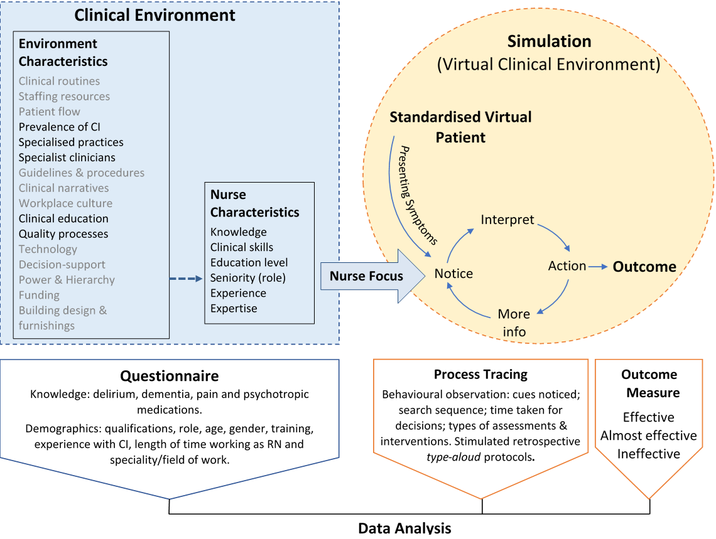

Notes:
Ericsson’s Expert Performance Approach—a methodology for identifying objectively superior performers—recommends recreating complex tasks in controlled and simulated conditions
This study therefore used a descriptive correlational design to observe nurses’ performance in a virtual simulation. The use of a standardised virtual patient meant that all participants were subject to the same case, facilitating comparability.
(click) A questionnaire captured nurse characterises and ...
(click) and performance outcomes were measured using process tracing
(click) this data was then correlated and compared in analysis
[01:31:56]

Slide 44
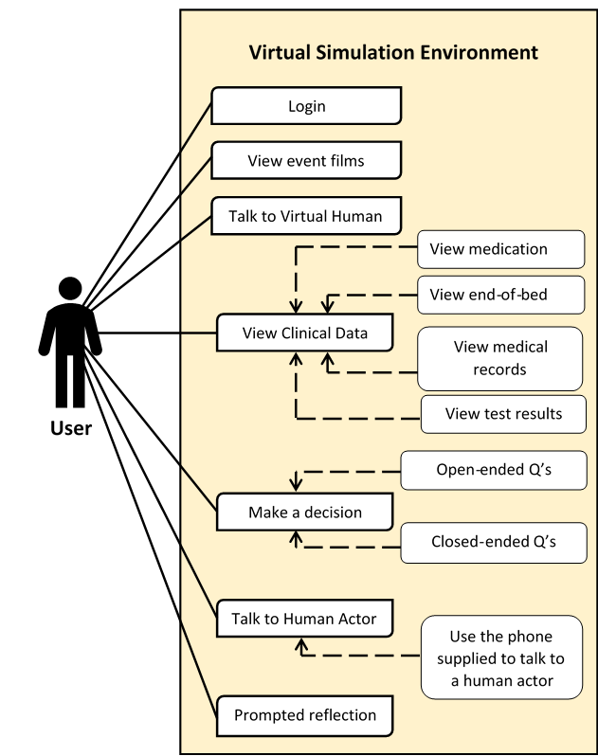
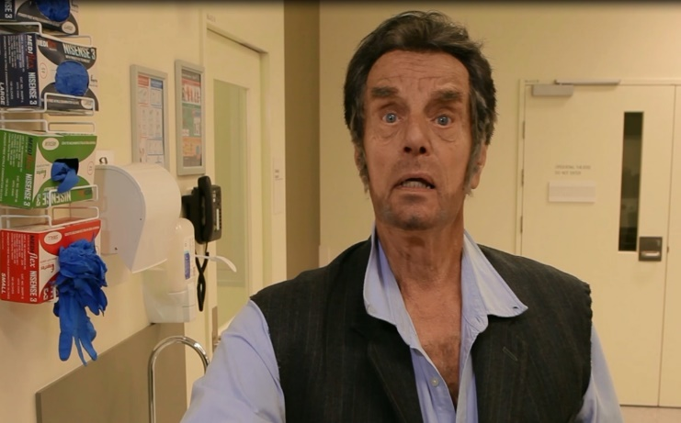
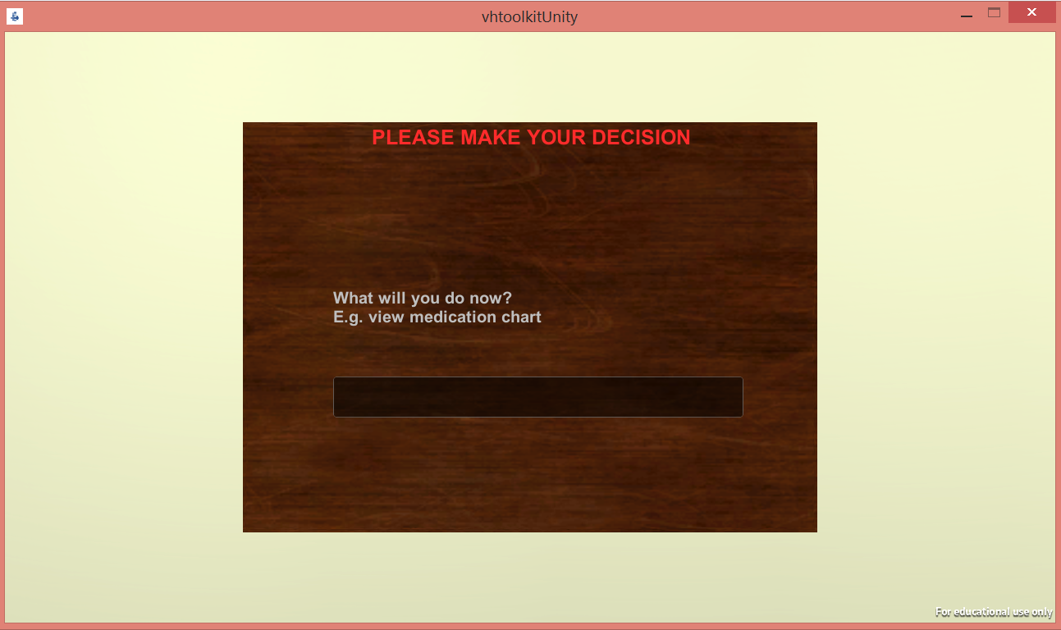
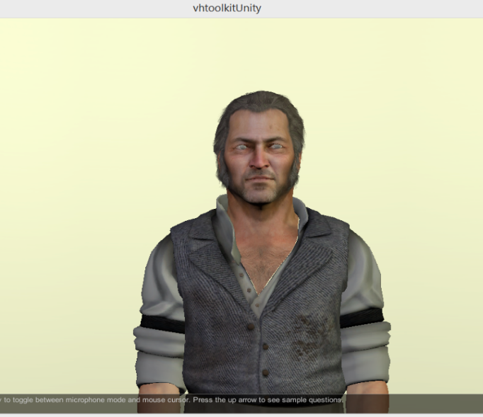
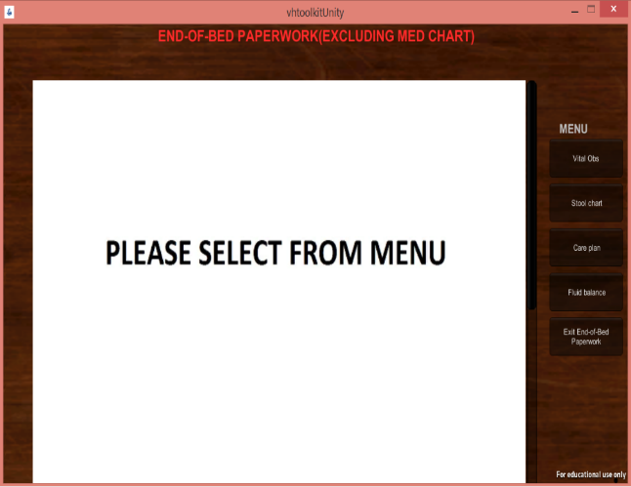

Slide 45
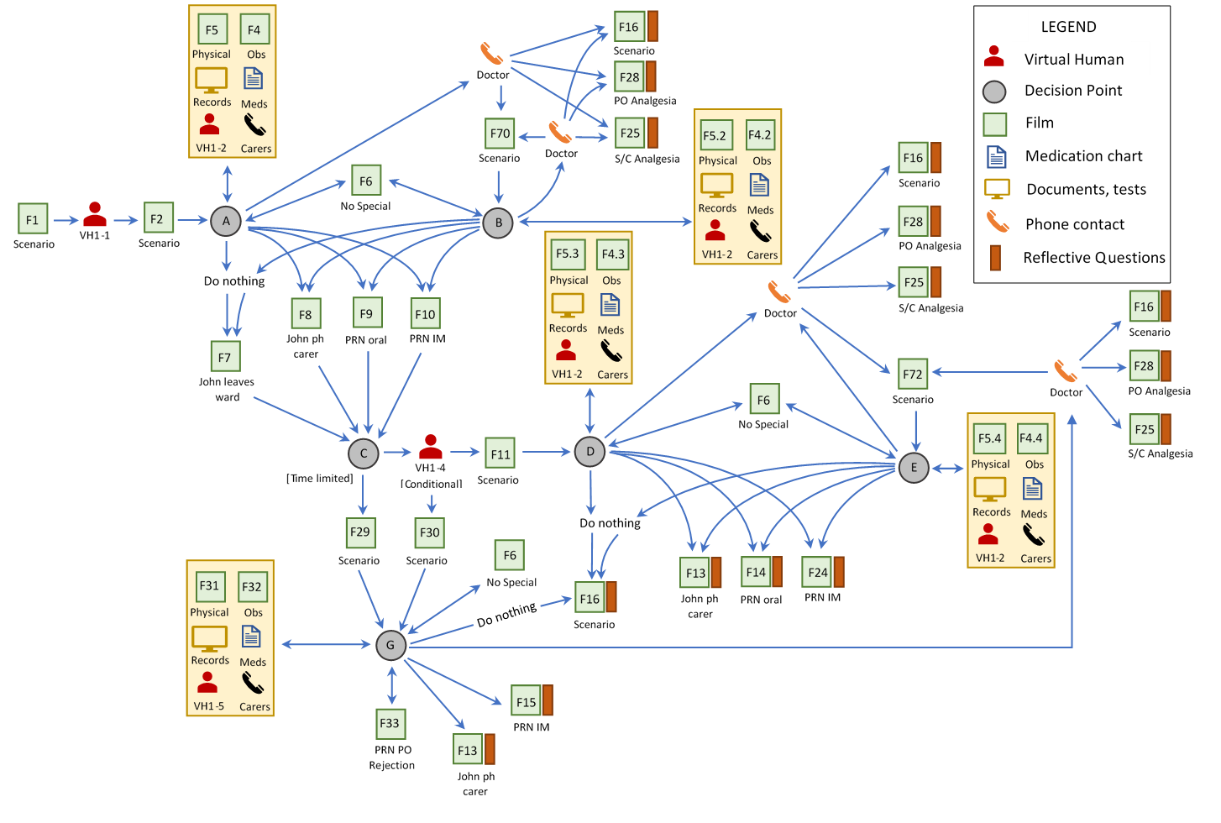
A Branching Pathway Design
Notes:
The branching simulation pathway design was complex and many pathways had to conceived based on a prediction of nurses’ behaviour.
In this pathway plan The Green box represents film, the red figure is the avatar and the grey circle is a decision point.
(click) As you can see the simulation pathways quickly become complex.
[sequence = [01:55:22]]

Slide 46
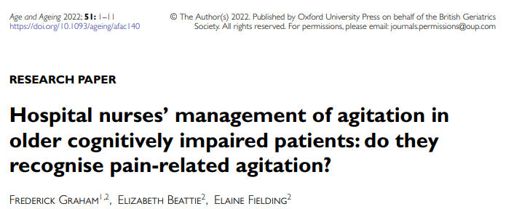
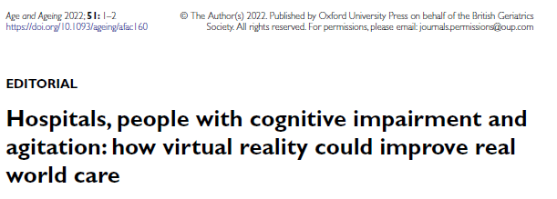
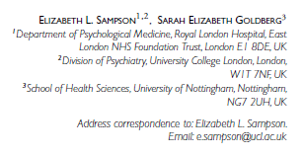
Tacit experiential knowledge, i.e., the unconscious classification of available cues, impacted RN ability to recognise pain-related agitation more than formal disease-based knowledge
  98% answered correctly that agitation was a sign of pain in people with dementia but less than 5% recognised it in the simulation, and instead almost 90% administered antipsychotics for agitation in patient with known fracture.
Use of multidisciplinary virtual simulation may provide a promising, safe, and affordable way for experiential learning about agitation at scale for the MDT
Immersive learning in practice – Deliberate practice models – repeated events, immediate and accurate feedback and motivated learners. How do we do this in practice as part of practice without disrupting workflow?
Experiential immersive placements for senior in charge nurses may help influence practice and culture change on wards

Slide 47
EXPLICATE-CN (Immersive placements study)
Background: nurses rely on social sources of expertise rather than guidelines. Furthermore, local cultural practices of wards affect assessment and care.
Aims: To observe if there are changes in behavioral outcomes for patients on wards where in-charge nurses (CNs) undertake immersive dementia-specific placements
1/3 of a wards CNs undertake a 5-week immersive placement with an acute-care dementia/delirium specialty service
Measure OV rates, behavioral outcomes on participating ward

Slide 48
Capacity building workplaces for dementia care
Specialists
Routines/practices
Improving patient care and decreasing OV and care burden
Environmental designs
BPSD workshop full day
Weekly unit CSP review
Skilled clinicians
Leisure
CSP
Clinical artifacts that focus care
Immersive experiential learning
Notes:
Whole team works within the unit to produce a 1-page cognition support plan that can go with the patients back into the community once proven effective.
Truly interprofessional practice.

Slide 49
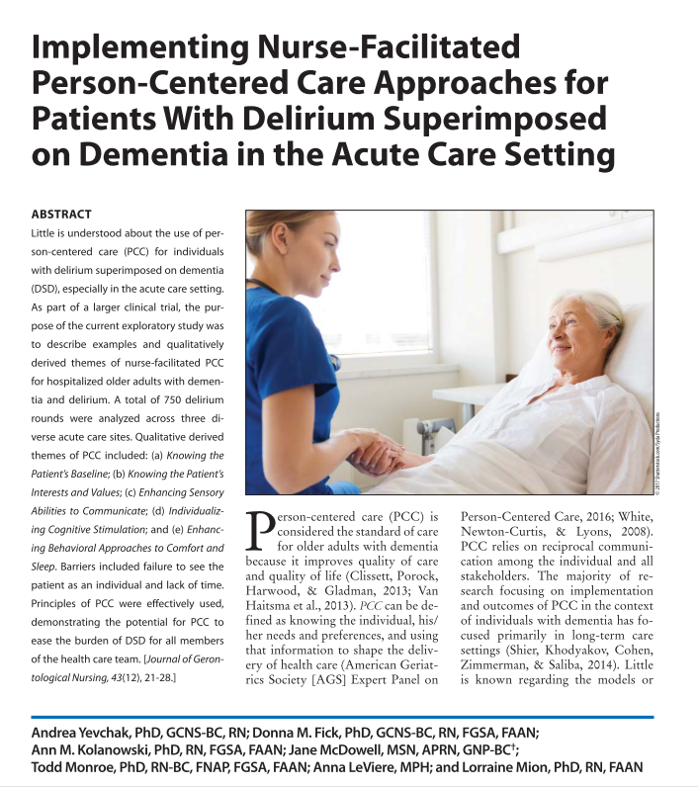
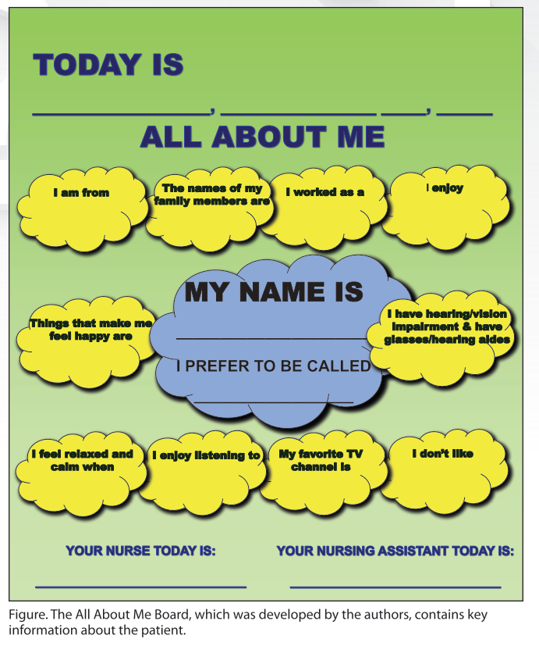

Biography (life story)
Provide care in accordance with preferences (hygiene, care routines, food, activity)
Sunflower wall chart in place at Princess Alexandra Hospital since 2006 (Graham, FA)
Do you know your patient? Fick, DiMeglio, McDowell, & Mathis-Halpin (2013) doi:10.3928/00989134-20130809-89
Notes:
FRED
Establish preferences and make sure you deliver care in accordance with these as much as able
Again, positive behaviour support pans for people with cognitive disabilities should be accessed as a priority early in any admission.

Slide 50
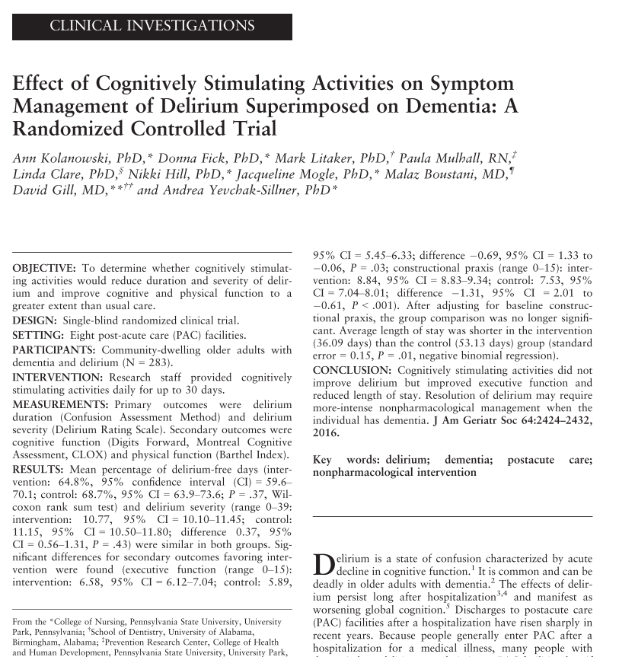
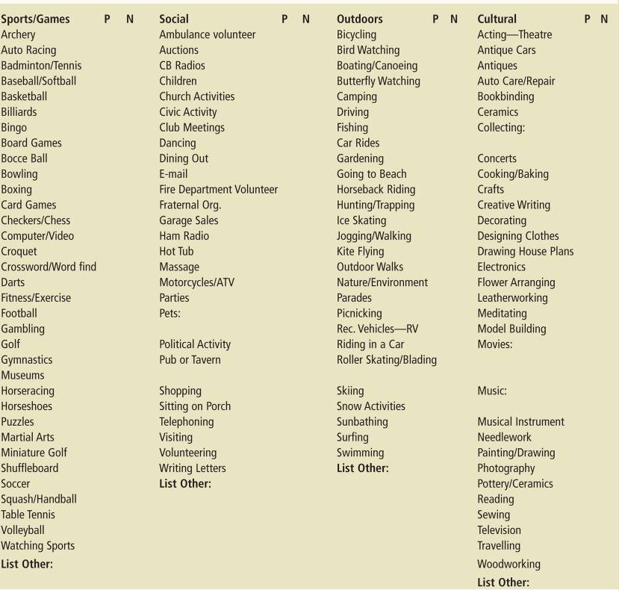
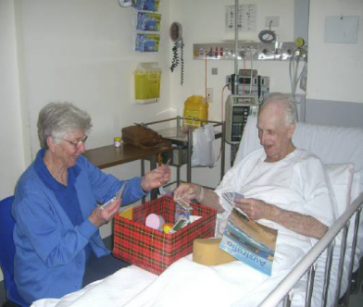
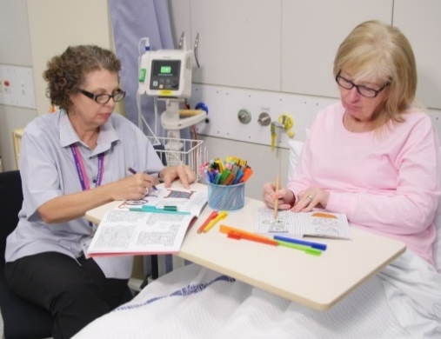
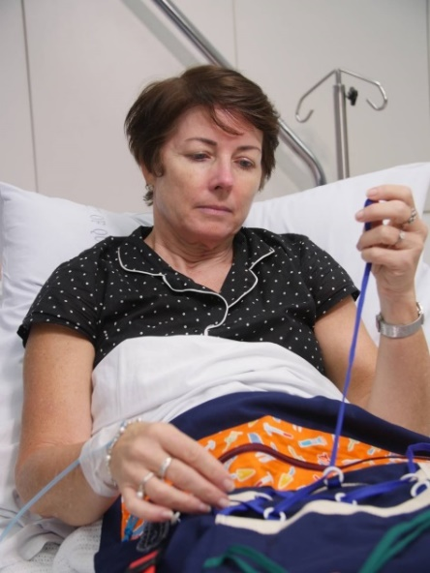
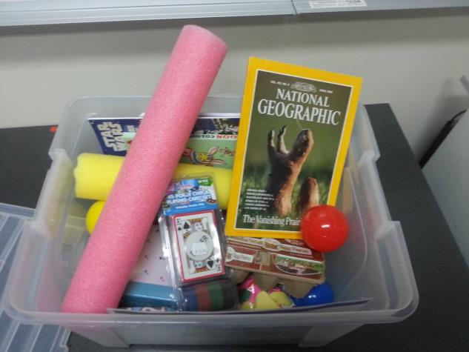
Introducing Cognitively Stimulating Activity
Cognition activity boxes on wards: provide some immediately available activity resources like adult colouring, cards, knitting, reading, word sorts,
Encourage family to provide items: A box of activities that stays with the patient
Notes:
FRED
What sort of resources and activities should you do?
How do you get nursing staff and others to engage in this type of activity as part of care?
Need resources and need to know what activities are preferred then need to make as part of care.

Slide 51

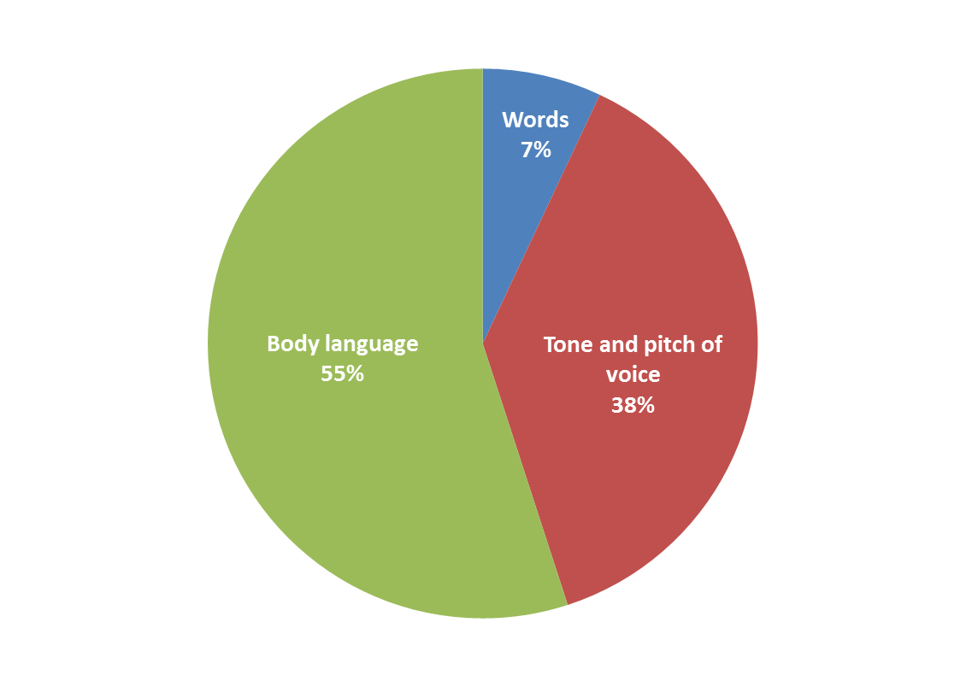
Use communication approaches that are established as affective for the individual
Prioritise obtaining relevant collateral:
Obtain from containing family, caregivers or
If there is a positive behaviour support plans or other developed plan, communication should be outlined there
Observe and assess in clinical situation
Seek specialist consultation (referral) for new or unestablished difficulties
Common to dementia, brain injury:
Aphasia
Apraxia
Agnosia
Remember!
Notes:
FRED
Apraxia is one of the most common cognitive issues seen in dementia. Apraxia is often associated with agnosia (loss of recognition) and/or aphasia (loss of language). The person is unable to perform tasks or purposeful movements when asked, even though they: understand the request or command.

Slide 52
Cognitive impairment – Comprehensive Care
PAIN: prioritise pain as a trigger. If pain is suspected, perform an analgesic trial and evaluate using patient’s self-report and observational pain tools.
CLINICIAL PROVOCATIONS: monitor for causes of delirium and discomfort using PITCHED – Pain, Infection, Thirst, Constipation, Hunger, Environment, Drugs
SUNFLOWER: contact family, complete and display positive life story info on chart to facilitate person-centred communication
TOP 5: contact family and document in progress notes “Tell me 5 things I need to know about caring for (X)?
NORMALISE: attempt to normalise context with regular calm orienting conversations.
HEALTH LITERACY: where appropriate, individualise education about the situation
SOCIAL: plan for staff to spend periods of social time with patient, spaced out regularly across the shift
ACTIVITY: encourage recreational activity. Ask families to provide an activity box (life story book & resources)
FAMILIARITY: use iPad or other technology to play video messages that family/friends have been encouraged to prerecord (1-2 minute messages)

