Slide 1
Lets have a conversation……..
What do you think we need to do to do?
Dr Sabrina Pit
Ian Johnston
Our funders
Digital Training for Women
Northern Rivers Wellbeing Program for people living with young onset dementia
Participants
22 September 2023

Slide 2
Program next 40 minutes
Survey Digital Safety Online (10 minutes)
Free Digital Training Program brief overview (5 minutes)
Conversations with Anne Moehead and Ian Johnston about Young Onset Dementia (10 minutes)
Overview Northern Rivers Wellbeing Program for people living with young onset dementia (5 minutes)
Your feedback on draft program
(5 minutes)

Slide 3
Survey Digital Safety Online
We are looking for people who would like to:
Learn more about using computers, mobile phones or other technology
Wish to support workshops or one on one trainings
Free workshops
Sign up sheets at the back ☺
We are also looking for free rooms to conduct the trainings throughout the whole of the Northern Rivers. Please contact us!

Slide 4
Digital Training Program overview
A FREE digital literacy training program.
Fourteen topics will be delivered as part of the training program and will be adjusted to your needs:
E-Safety
Scams
Passwords
Email
Wi-Fi
Apps
Watching and Listening Online
Video calling
Social Media
Mobile Banking
MyGov
Games
Emergency App
Creativity using AI
OTHER TOPICS YOU WISH TO SEE.
We will use Zoom, individual and face-to-face meetings adjusted to YOUR needs
A survey will be done before and after
Where? Northern Rivers libraries and other local venues.
Participants

Slide 5
Join us!
01
Share with friends and family key points:
Digital training workshops for carers or people living with dementia
A group for people with younger onset dementia
We are looking for volunteers to help us for both programs.
SIGN UP FOR DIGITAL TRAINING PROGRAM OR THE YOUNGER ONSET DEMENTIA WELLBEING PROGRAM BY CONTACTING US AT:
DementiaInclusiveBallina@gmail.com
dementiainclusiveballina.org.au
Sabrina@workwiser.com.au, or text or ring Sabrina on 0429455720
We love to chat about how we can work together and have more volunteers!
OR SIGN UP AT THE BACK OF THE ROOM!

Slide 6
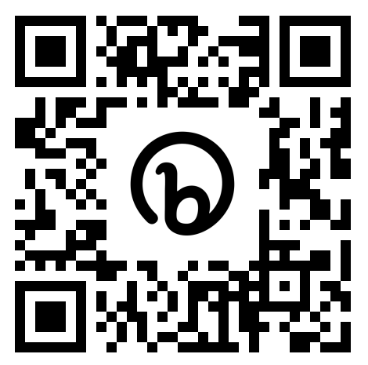
Dementia in Practice podcast
A podcast made by GPs for GPs and others interested in learning more about dementia
Two most popular podcasts about living with younger onset dementia:
https://omny.fm/shows/dta/dementia-in-practice-s2-ep-3-1?in_playlist=dementia-in-practice
https://omny.fm/shows/dta/dementia-in-practice-s2-ep-3-2?in_playlist=dementia-in-practice
Notes:
HK

Slide 7
Northern Rivers Wellbeing Program for People with young onset dementia
Program Topics
01
Selfcare
02
Household maintenance & tasks
03
What is missing?
Employment and recreation
04
Shopping and money
What would you like to see?
05
Travel
06
Communication

Slide 8
The End!
01
Share with friends and family and sign up for :
Digital training workshops for carers or people living with dementia
A group for people with younger onset dementia
We are looking for volunteers to help us.
SIGN UP FOR DIGITAL TRAINING PROGRAM OR THE YOUNGER ONSET DEMENTIA WELLBEING PROGRAM BY CONTACTING US AT:
DementiaInclusiveBallina@gmail.com
dementiainclusiveballina.org.au
Sabrina@workwiser.com.au, or text or ring Sabrina on 0429455720
We love to chat about how we can work together and have more volunteers!
OR SIGN UP AT THE BACK OF THE ROOM!

